Slide 1
C Programming
Ashutosh Sonawane

Slide 2
Hardware and OS Introduction
Ashutosh Sonawane

Slide 3
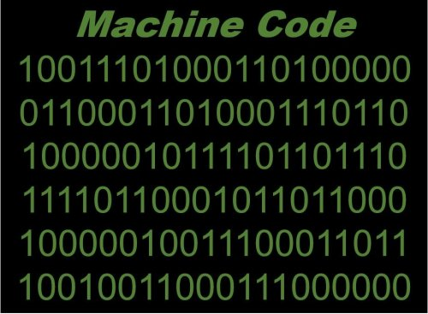









Hardware

Slide 4








Operating System
OS
Software
Powerful
Faster
Simple
Easy

Slide 5
Where is console? and How to use?
In Windows:- CMD | Linux Or Mac:- Terminal
Through the Commands
Sr.No. | Windows | Linux/Mac | Description
1 | chdir | pwd | Returns your current directory location
2 | dir | ls –l | Directory(Folder) listing
3 | cd | cd | Change the current directory
4 | md | mkdir | To create a new directory/folder
5 | copy | cp | Copying a file(Copy, Paste)
6 | move | mv | Moving a file(Cut, Paste)
7 | del | rm | Delete file
8 | rmdir | rmdir | To delete a directory.
 |  | rm –rf
9 | type | cat | To print contents of a file.
10 | fc | diff | Compare contents of files
11 | cls | clear | Clear Screen
Sr.No. | Windows | Linux/Mac | Description
11 | find | grep | Search for a string in a file
12 | echo | echo | To print something on the screen
13 | noteoad(depends on editor) | vim(depends on editor) | To write in to files.
14 | tasklist | ps x | To list running tasks.
15 | set var=value | export var=value | To set environment variables.
16 | attrib | chown | To change file permissions.
 |  | chmod
17 | ping | ping | To send ICMP ECHO_REQUEST to network hosts.
18 | chdisk | du -s | For disk usage.
19 | command /? | man command | Display the manual/help details of the command
20 | where | whereis | locate the binary file

Slide 6
C Programming
Ashutosh Sonawane

Slide 7
History of C Programming
C Programming Language was introduced by Mr. Dennis Ritchie in 1972. He invented this language for the internal use of AT & T Bell Labs. But due to the features of C Programming Language it became very popular.
Problems with languages existing before C –
They were categorized in Lower Level Languages and Higher Level Languages. The Lower Level Languages were designed to give better machine efficiency, i.e. faster program execution. The Higher Level Languages were designed to give better programming efficiency i.e. faster program development.
The languages before C were Application Specific e.g. FORTRAN (FORmula TRANslation) was built for Engineering Applications Development, COBOL (COmmon Business Oriented Language) was developed for Commercial Application Development.
Dennis Ritchie thought about giving features of both Lower Level Languages and Higher Level Languages. So he introduced the concept of Compilers in C. The function of compiler is to "Convert the code from Human Readable Language to Machine Readable Language".

Slide 8








What is Compilers(or interpreter)?
Africa
कृपया मेरी तस्वीर ले लो
Ek verstaan ​​nie
One Line at a Time
(She must be there)
All passage at a Time
(He not needed to be there)

Slide 9
What is Compilers(or interpreter)?
SOURCE CODE :-In computing, source code is any collection of code, with or without comments, written using a human-readable programming language, usually as plain text.
MACHINE CODE :-In computer, programming, machine code, consisting of machine language instructions, is a low-level programming language used to directly control a computer's central processing unit.
COMPILER :-In computing, a compiler is a computer program that translates computer code written in one programming language into another language. The name "compiler" is primarily used for programs that translate source code from a high-level programming language to a lower level language to create an executable program.
INTERPRETER :-In computer, an interpreter is a computer program that directly executes instructions written in a programming or scripting language, without requiring them previously to have been compiled into a machine language program.

Slide 10
GCC Installation
ASHUTOSH SONAWANE

Slide 11
On Linux
sudo apt update
sudo apt upgrade
sudo apt install build-essential
gcc --version or g++ --version

Slide 12
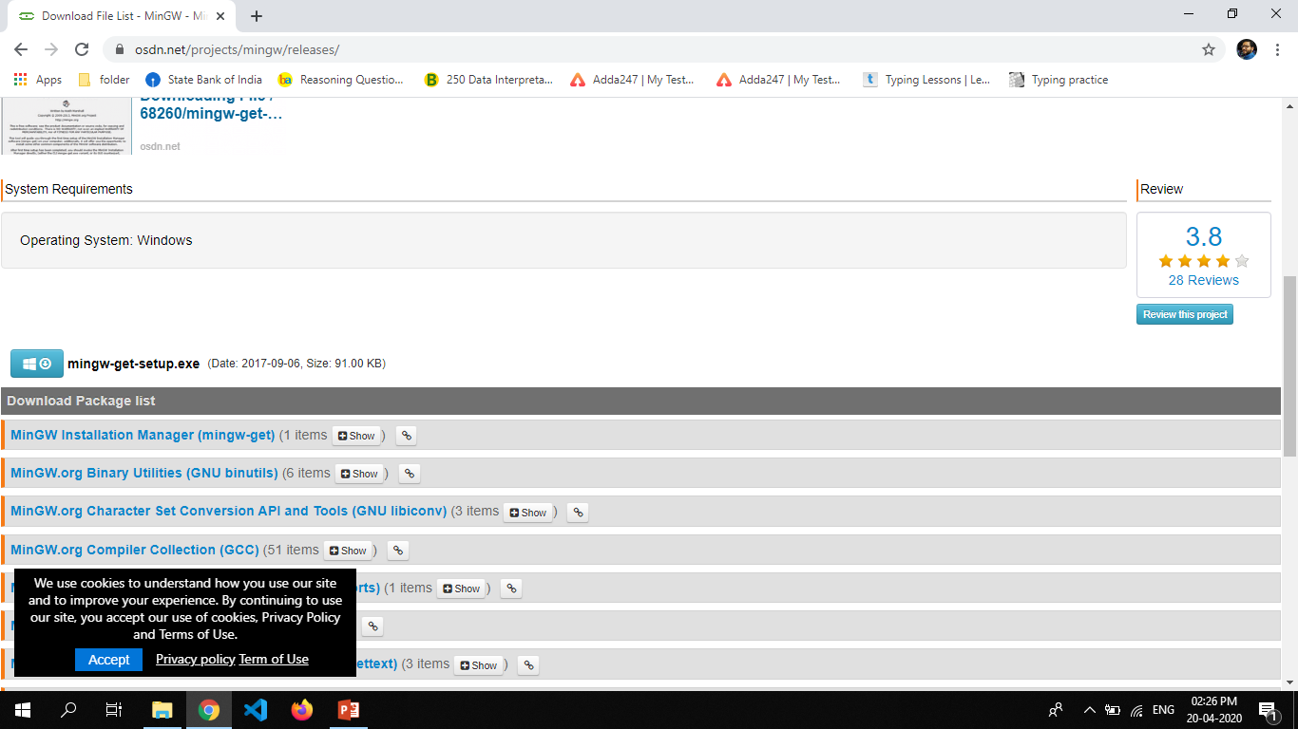
On Windows
For windows you have install MinGW software.
http://www.mingw.org/
Find download link on top right
Click on that link it will redirect you to download page
Find the download option and click on that
After that it will download online installer
Double click on that
Click here

Slide 13
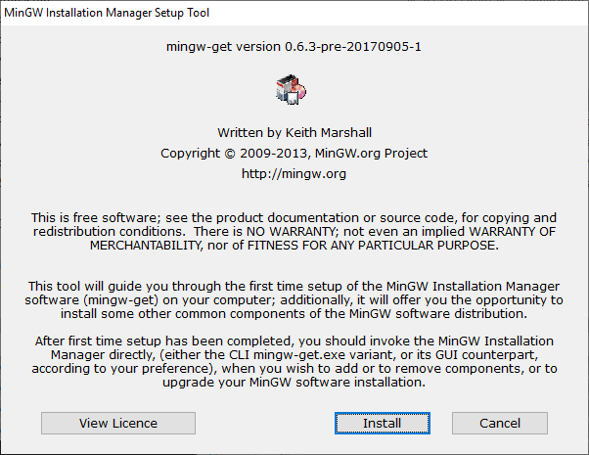
On Windows

Slide 14
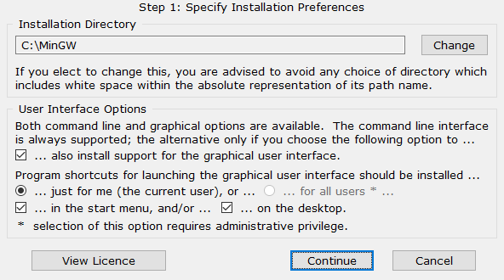
On Windows

Slide 15
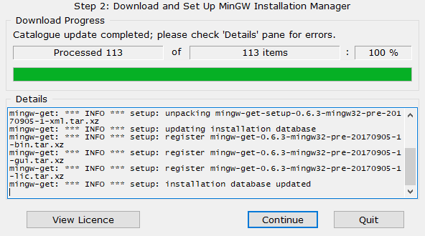
On Windows

Slide 16
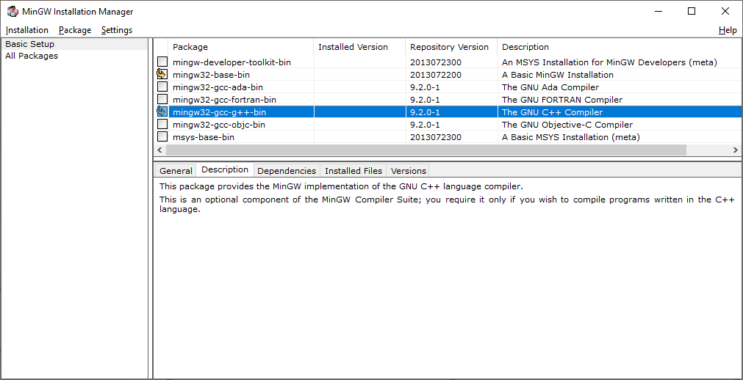
On Windows

Slide 17
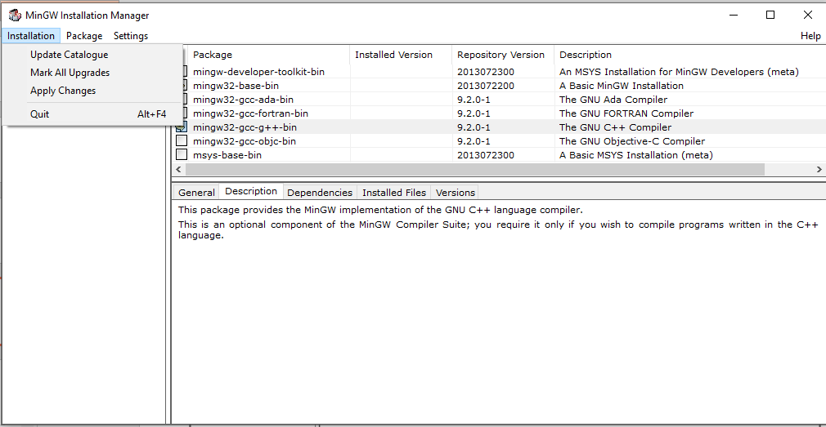
On Windows

Slide 18
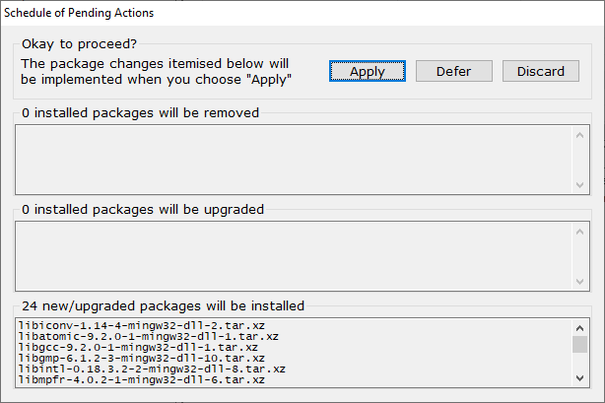
On Windows

Slide 19
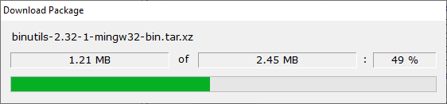
On Windows

Slide 20
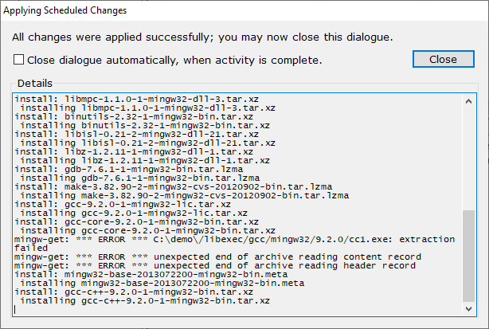
On Windows

Slide 21
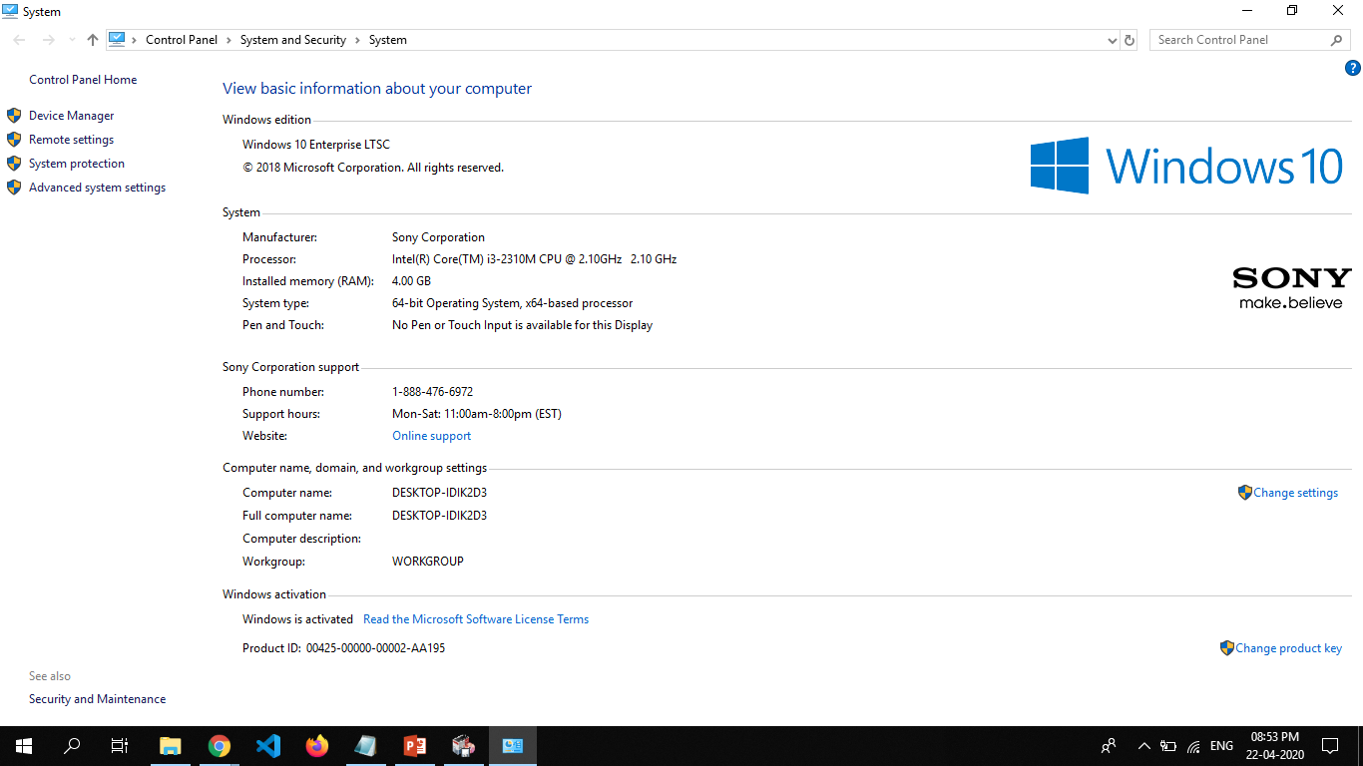
On Windows(Set Path)

Slide 22
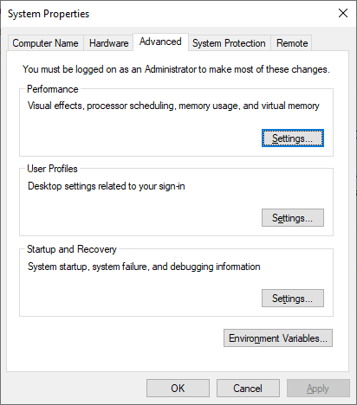
On Windows(Set Path)

Slide 23
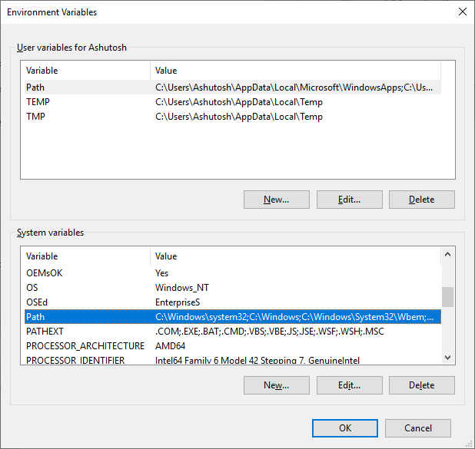
On Windows(Set Path)

Slide 24
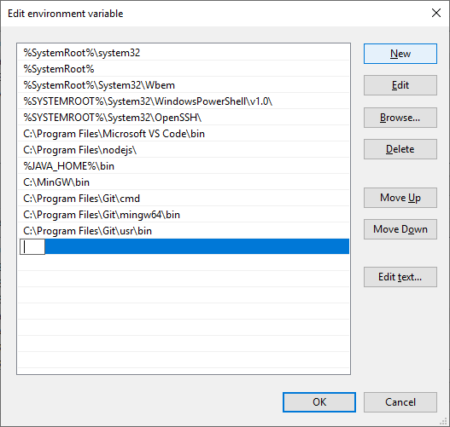
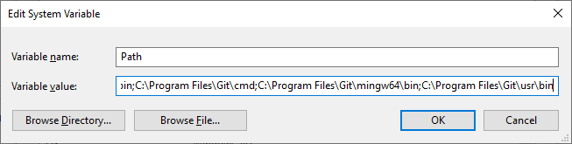
On Windows(Set Path)

Slide 25
History of C Programming(C versions)
1960
ALGO
International Group
1967
BPCL
Martin Richard
1970
B
Ken Thompson with Dennis Ritchie
1972
C (B language rename to C)
Dennis Ritchie
1973
Unix re-written in C
1978
The C Programming Language, 1st edition
1988
The C Programming Language, 2nd edition

Slide 26
History of C Programming(C versions)
1989
C89
the ANSI(American National Standards Institute) C standard published
1990
C90
the ANSI C standard accepted as ISO/IEC 9899-1990(ISO:-International Organization for Standardization)
1995
C95
ISO/IEC 9899 AM1(greatly expanded wide and multibyte character support)
1999
C99
(ISO/IEC 9899:1999)(new features: bool, long long, and some header files)
2011
C11
2018
C17
(ISO/IEC 9899:2011)(thread-aware memory model, removed gets)
fixes defect reports

Slide 27

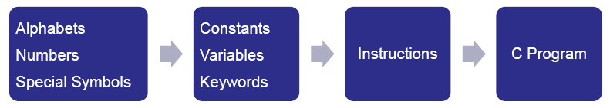
Basics of C Programming
Steps in Learning English Language:
Steps in Learning C Language:

Slide 28
Basics of C Programming
'C' Alphabets: (ASCII character set)
Whitespace | Space, horizontal tab, vertical tab, form feed, new-line
Alphabets | A, B, ……, Y, Z a, b, ……..., y, z
Numbers | 0, 1, 2, 3, 4, 5, 6, 7, 8, 9
Special Symbols | ~ ' @ # % ^ & ( ) _ - + | \ { } [ ] : ; " ' < > , . ? /

Slide 29
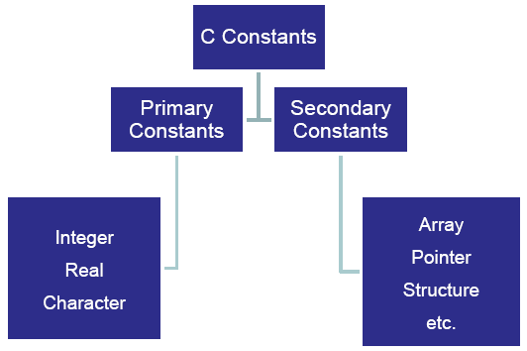
Basics of C Programming
'C' Constants:
A constant is an entity that never changes. There are two type of C Constants – Primary Constants, Secondary Constants.

Slide 30
Basics of C Programming
More details
Rules for Constructing Integer Constants:
An Integer Constant must have at least one digit.
It must not have a decimal point.
It can be either positive or negative.
If no sign precedes an Integer Constant, it is assumed to be positive.
No commas or blanks are allowed in integer constant.
The allowable range is: -2,14,74,83,648 to 2,14,74,83,647.
Rules for Constructing Real Constants:
A Real Constant must have at least one digit.
It must have at least one decimal point.
It can be either positive or negative.
Default sign is positive.
No commas or blanks are allowed within Real Constants.
It's range is: 3.4e-38 to 3.4e38.
Rules for Constructing Character Constants:
A character constant is a single alphabet, a single digit or a single special symbol enclosed within single inverted commas ‘’. Both the inverted commas should point to the left.
More details
More details
for String

Slide 31
Basics of C Programming
'C' Variables:
An entity that may vary during the program execution is called as Variable.
Variable names are names given to the memory locations.
These locations can hold integer, real or character constants.
The integer variable needs 4 bytes, float variable needs 4 bytes, double variable needs 8 bytes and char variable needs 1 byte memory space.(more about datatype)

Slide 32
Basics of C Programming
Rules for Constructing a Variable Name:
The variable name should not exceed 30 characters. Some compilers allow variable names upto 247 characters. But restrict variable name, as it adds to the typing effort.
The variable name can be Alpha-numeric e.g. no1
But it should start with an alphabet.
It should not contain any spaces in between.
It should not contain any special symbols except underscore (_) in between e.g. area_circle
It should not contain any Keyword.

Slide 33
Data Types Revised
Type | Storage size | Value Range
char | 1 byte | -128 to 127 (0 to 255)
unsigned char | 1 byte | 0 to 255
int | 2/4 bytes | (-32,768 to 32,767)/(-2,147,483,648 to 2,147,483,647)
unsigned int | 2/4 bytes | (0 to 65,535)/(0 to 4,294,967,295)
short(short int) | 2 bytes | -32,768 to 32,767
long | 4/8 bytes | (-2147483648 to 2147483647) / (-9223372036854775808 to 9223372036854775807)
unsigned long | 4/8 bytes | (0 to 4,294,967,295) / (0 to 18,446,744,073,709,551,615)
long long | 8 bytes | -9,223,372,036,854,775,808 to 9,223,372,036,854,775,807
unsigned long long | 8 bytes | 0 to 18,446,744,073,709,551,615
float | 4 bytes | 1.2E-38 to 3.4E+38 (6 decimal places)(IEEE 754)
double | 8 bytes | 2.3E-308 to 1.7E+308 (15 decimal places) (IEEE 754)
Long double | 10/12/16 bytes | 3.4E-4932 to 1.1E+4932 (19 decimal places) (x86 extended-precision floating-point format)
For More detail checked limit.h file

Slide 34
Basics of C Programming
Keywords:
The words which are assigned with special meaning to them in C Compiler are called as keywords. As they are assigned with special meaning, they can not be used as variable names. There are only 32 keywords available in C.
auto | double | int | struct
break | else | long | switch
case | enum | register | typedef
char | extern | return | union
const | float | short | unsigned
continue | for | signed | void
default | goto | sizeof | volatile
do | if | static | while
More details click here

Slide 35
Basics of C Programming
'C' Instructions:
Type Declaration Instruction: These instructions are used to declare the type of variables used in a C Program.
int no1, no2, sum;
float radius, area;
char ch;
Arithmetic Instructions:
Arithmetic Operators –
More details
In normal math's, we write instruction as follows –
A + B = C
In C, we write the same as –
C = A + B
In C '=' is used to assign values to variables.
Addition | + | 5 + 2 = 7
Subtraction | - | 5 – 2 = 3
Multiplication | * | 5 * 2 = 10
Division | / | 5 / 2 = 2
Modulus | % | 5 % 2 = 1

Slide 36
Basics of C Programming
More details
Priority of operators –
Control Instructions: In C Programming the execution of program happens from top to bottom. There are certain instruction in C which can change the flow of the program. These instructions are called as control instructions. e.g. while, for, goto etc.
Priority | Operators | Description
1st | ( ) | Brackets
2nd | * / % | Multiplication, Division, Modulus
3rd | + - | Addition, Subtraction
4th | = | Assignment

Slide 37
Basics of C Programming
Basic Structure of a C Program:
# – preprocessor instruction
include<x> – To include a file x to the C Program
stdio.h / conio.h – Header Files
void main() – Start of a program
{ } – Scope of a Program
#include<stdio.h>
void main()
{
……….;
……….;
……….;
}

Slide 38
Rules for Writing a C Program
Each Instruction in C Program is written as a separate statement.
The statements in program must appear in the same order which we wish them to be executed, unless the logic of the program demands a deliberate 'jump' or transfer of control to a statement, which is out of sequence.
Blank spaces my be inserted between two words to improve the readability of the statement.
All syntax should be entered in small case letters.
Every C statement must end with a ;. Thus ; acts as a statement terminator.
There is no specific rule for the position at which the statement is to be written. That's why it is often called as free-form language.

Slide 39
First C Program
#include<stdio.h>
void main()
{
printf("This is my first C Program"); /*to print the statement*/
}
The program should be properly documented. The statements enclosed in /* */ are called as comments.
Single line comments can also be given using //.
The program should be properly indented.
printf() is a function which prints the string embedded in between " " on the console.

Slide 40
Declaring & Assigning Values to Variables
#include<stdio.h>
void main()
{
int no1;
float no2;
char ch;
no1 = 10;
no2 = 25.75;
ch = 'A';
printf("Integer = %d, Real = %f, Character = %c", no1, no2, ch);
getch(); /*waits for user to press any key on console*/
}
Note: You can assign the
values to the variables at
the time of declaration
also e.g. int no1 = 10;
%d is format specifier for integers.
%f is format specifier for real.
%c is format specifier for character.

Slide 41
scanf() Function
To receive the values from user scanf() function is used.
You can receive the single or multiple values within a single scanf.
e.g. scanf("%d", &no1) or scanf("%d%d", &no1, &no2);
Generally before any scanf() statement printf() statement should be written to guide the user for giving input.
& means address of the variable.
#include<stdio.h>
void main()
{
int no1;
printf(“\nEnter any number: ");
scanf("%d", &no1); /*receives the value from console*/
}

Slide 42
List of Escape Sequences
\a Alarm or Beep
\b Backspace
\f Form Feed
\n New Line
\r Carriage Return
\t Tab (Horizontal)
\v Vertical Tab
\\ Backslash
\' Single Quote
\" Double Quote
\? Question Mark
\ooo octal number
\xhh hexadecimal number
\0 Null

Slide 43
List of Format specifiers
Format Specifier | Type
%c | Character
%d | Signed integer
%e or %E | Scientific notation of floats
%f | Float values
%g or %G | Similar as %e or %E
%hi | Signed integer (short)
%hu | Unsigned Integer (short)
%i | Unsigned integer
%l or %ld or %li | Long
%lf | Double
%Lf | Long double
Format Specifier | Type
%lu | Unsigned int or unsigned long
%lli or %lld | Long long
%llu | Unsigned long long
%o | Octal representation
%p | Pointer
%s | String
%u | Unsigned int
%x or %X | Hexadecimal representation
%n | Prints nothing
%% | Prints % character

Slide 44
The Decision Control Structure
if statement
Many times we have to take actions based on certain conditions. C provides if or if-else statement to allow you to execute statements based on the conditions.
In C language there is no Boolean value i.e. (True and False). In C Zero means false and non zero means true.
Before going into details of conditional statements you must know the
Relational Operators –
More details
less than | < | x < y
greater than | > | x > y
less than equal to | <= | x <= y
greater than equal to | >= | x >= y
equal to | == | x == y
not equal to | != | x != y

Slide 45
Forms of if-else Statements
if(condition)
……..; //Single Statement
if(condition)
{ //multi line Statements {} compulsory
……..;
……..;
}
if(condition)
……..;
else
……..;
if(condition)
{
……..;
……..;
}
else
……..;
if(condition)
……..;
else
{
……..;
……..;
}
if(condition)
{
……..;
……..;
}
else
{
……..;
……..;
}

Slide 46
Nested if-else Statements
if(condition)
{
if(condition)
{
……..;
……..;
}
else
{
……..;
……..;
}
}
else
{
if(condition)
{
……..;
……..;
}
else
{
……..;
……..;
}
}

Slide 47
Logical Operators
if(cond1 && cond2 && …… && condN)
{
……..;
……..;
}
If all the conditions joined by && are true then the statements will be executed.
if(cond1 || cond2 || …… || condN)
{
……..;
……..;
}
If any of the conditions joined by || is true then the statements will be executed.
if((cond1 && cond2) || (cond3 && cond4))
{
……..;
……..;
}
C contains Logical Operators && (AND), ||(OR) and ! (NOT).
&& and || allow to join multiple conditions.
! Operator reverses the result of the expression it operates on.
Examples -
if(!flag) /*will reverse value of flag*/
{
……..;
……..;
}

Slide 48
The else if Statement
void main()
{
int no1=15, no2=10, no3=8;
if (no1 > no2 && no1 > no3)
printf("The no1 is maximum");
if(no2 > no1 && no2 > no3)
printf("The no2 is maximum");
if(no3 > no1 && no3 > no2)
printf("The no3 is maximum");
}
In the above example even if the first number is maximum the other two if statements are also checked and this will increase the execution time of the program.
void main()
{
int no1=15, no2=10, no3=8;
if (no1 >no2 && no1 > no3)
printf("The no1 is maximum");
else if(no2 > no1 && no2 > no3)
printf("The no2 is maximum");
else
printf("The no3 is maximum");
}
In the above example if the fist 'if' goes false then only second if will get executed and if the second 'if' goes false then the last else will get executed.

Slide 49
The Conditional Operators
The conditional operators ? and : are sometimes called as ternary operators since they take three arguments. Their general form is –
expression1 ? expression 2 :expression3
The above expression suggests "if expression1 is true (that is, if it's value is non-zero), then the value returned will be expression2, otherwise value returned will be expression3.
int x, y;
scanf("%d", &x);
y = (x > 5 ? 3 : 4);
This expression will store 3 in y if x is greater than 5 otherwise it will store 4 in y.
int i;
scanf("%d",&i);
If(i==1 ? printf("Amit") : printf("Rohit));
char a = 'z';
printf("%c", (a >= 'a' ? a : '!'));
int big, a, b, c;
big=(a>b ? (a>c ? 3 : 4) : (b>c ? 6 : 8));

Slide 50
Some basic program
C "Hello, World!" Program
C Program to Print an Integer (Entered by the User)
C Program to Add Two Integers
C Program to Multiply two Floating Point Numbers
C Program to Find ASCII Value of a Character
C Program to Compute Quotient and Remainder
C Program to Find the Size of int, float, double and char
C Program to Demonstrate the Working of Keyword long
C Program to Check Whether a Number is Even or Odd
C Program to Check Whether a Character is Vowel or Consonant
C Program to Find the Largest Number Among Three Numbers
C Program to Check Leap Year
C Program to Check Whether a Number is Positive or Negative
C Program to Check Whether a Character is an Alphabet or not
C Program to Find all Roots of a Quadratic Equation
C Program to Demonstrate Format Specifiers in c
C Program to Demonstrate Escape Sequences.

Slide 51
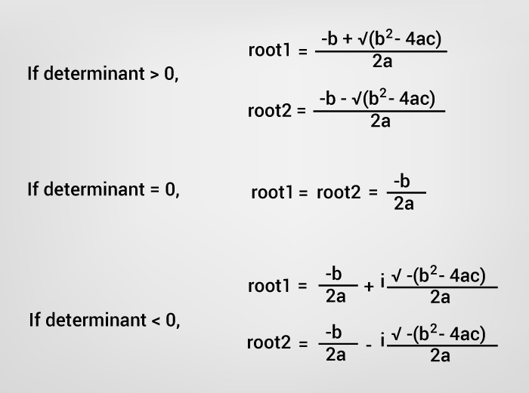
The term b²-4ac is known as the determinant of a quadratic equation.

Slide 52
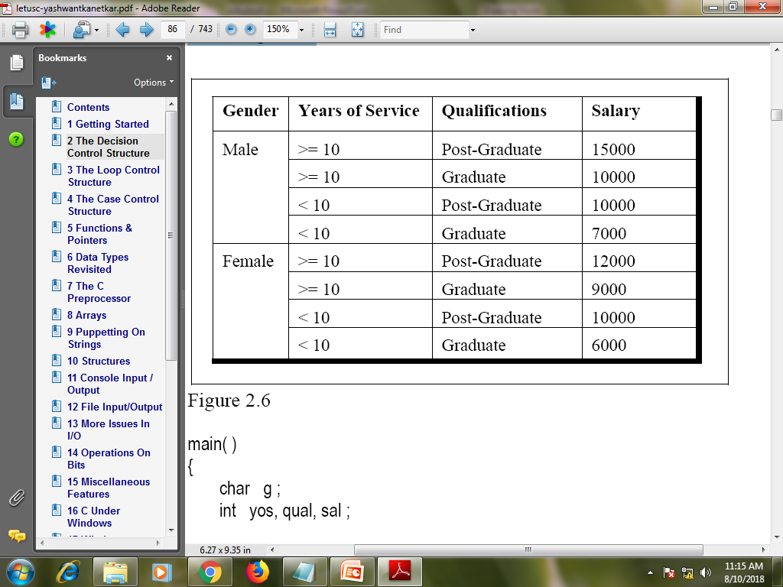
Write a program to calculate the salary as per the following table:

Slide 53
If cost price and selling price of an item is input through the keyboard, write a program to determine whether the seller has made profit or incurred loss. Also determine how much profit he made or loss he incurred.
Write a program to check whether a triangle is valid or not, when the three angles of the triangle are entered through the keyboard. A triangle is valid if the sum of all the three angles is equal to 180 degrees.
A university has the following rules for a student to qualify for a degree with A as the main subject and B as the subsidiary subject:
He should get 55 percent or more in A and 45 percent or more in B.
If he should get 55 percent or more in B. However, he should get at least 45 percent in A.
If he gets less than 45 percent in B and 65 percent or more in A he is allowed to reappear in an examination in B to qualify.
In all other cases he is declared to have failed.
Write a program to receive marks in A and B and Output whether the student has passed, failed or is allowed to reappear in B.

Slide 54
The Loop Control Structure
The while loop:
In programming sometimes you want to run a block of code repeatedly till certain number of times. The while loop helps you to achieve this task.
The general form of while loop is –
initialize the loop counter;
while( test the loop counter using a condition )
{
.........;
………;
increment / decrement loop counter;
}

Slide 55
More Operators
++ and --operators:
When you want to do increment by one i.e. if you want to write i = i + 1, you can use i++ or ++i;
Same way if you want to do decrement by on i.e. if you want to write i = i –1, you can use i-- or --i.
There is a difference between pre-increment / post-increment or pre-decrement / post-decrement operators. e.g.
int i = 10, j;
j = i++;
printf(" %d %d", i, j); /* 11 10*/
int i = 10, j;
j = ++i;
printf(" %d %d", i, j); /* 11 11*/
In the first example the value of i is first assigned to j and then the value of i gets incremented.
In the second example the value of i is first incremented and then it is assigned to j.
Compound Assignment Operators:-
i = i + 5 | i+=5 | i = i –5 | i-=5
i = i * 5 | i*=5 | i = i / 5 | i/=5
i = i % 5 | i%=5

Slide 56
Nesting of while loop
void main()
{
int r = 1, c;
while(r <= 4)
{
c = 1;
while (c <= 4)
{
printf("*");
c++;
}
printf("\n");
r++;
}
}
The way we have seen nesting of 'if' statements, we can do nesting of loops. Nesting of loop means loop into another loop. Example –
****
****
****
****
In the above example, you have to print multiple stars in columns for each row. Such times you need nesting of loops.

Slide 57
do while Loop
#include<stdio.h>
#include<conio.h>
void main()
{
int no1, no2, sum;
char ch;
do
{
printf("Enter 2 nos: ");
scanf("%d%d", &no1, &no2);
sum = no1 + no2;
printf("Sum = %d", sum);
printf("Want to continue <y/n>: ");
flushall();
scanf("%c", &ch);
} while(ch == 'y');
}
The difference between while and do while is the do while loop at least gets executed single time.
initialize the loop counter;
do
{
...........;
………;
increment / decrement loop counter;
} while (condition);
do while loop is generally used with odd loops. When the programmer does not know how many time the loop will get executed the odd loops are used.

Slide 58
for Loop
for loop specify three things about the loop in a single line.
The general form of for statement is as follows –
for(initialize; condition; increment / decrement)
{
………..;
………..;
}
e.g.
for(i = 0; i <= 10; i++)
{
printf("%d", i);
}
In for loop the initializations are done only at the first time. Then condition is checked and while going outside the loop the loop counter is incremented or decremented.
You can do multiple initializations or multiple increments / decrements using comma separation.
e.g.
for(i = 0, j = 5; i < j; i++, j--)
{
printf("%d %d", i, j);
}

Slide 59
break, continue Statement
Break statement is used to jump out of the loop instantly.
e.g.
for(i = 0; i <= 10; i++)
{
if(i == 5)
break;
printf("%d ", i);
}
The output of the above program is:
0 1 2 3 4
Continue statement takes the control of the program to the beginning of loop.
e.g.
for(i = 0; i <= 10; i++)
{
if(i == 5)
continue;
printf("%d ", i);
}
The output of the above program is:
0 1 2 3 4 6 7 8 9 10

Slide 60
The goto Keyword
void main()
{
int i;
for(i = 0; i < 10; i++)
{
if(i == 5)
goto xyz;
else
printf(" %d", i);
}
xyz:
printf("\nI am out of main");
}
The output is:
0 1 2 3 4
I am out of main
goto keyword allows to jump the program from one location to another.
Though it is easy to use, but it makes the program unreliable, unreadable and hard to debug. So avoid using it or use it in a very unavoidable circumstances.
The word followed by goto keyword is called as label. It takes the control to that specific label.

Slide 61
switch case Control Structure
The switch-case-default allows us to make decision from many choices.
The expression followed by switch should be integer or character.
The keyword case is followed by integer or character constants.
When user gives some choice the switch statement takes the control to the specified case.
If no such case exists, then control goes to default.
Each case ends with break.
You cannot use logical && or ||operators with cases.
switch(choice)
{
case 1:
………..;
break;
case 2:
………..;
break;
case 3:
………..;
break;
default:
………..;
}

Slide 62
Programs using loops
C Program to Calculate the Sum of Natural Numbers
C Program to Find Factorial of a Number
C Program to Generate Multiplication Table
C Program to Display Fibonacci Sequence(0,1,1,2,3,5,8,13,21,34)
C Program to Find GCD of two Numbers
C Program to Find LCM of two Numbers
C Program to Display Characters from A to Z with their ASCII value Using Loop
C Program to Count Number of Digits in an Integer
C Program to Reverse a Number
C Program to Calculate the Power of a Number
C Program to Check Whether a Number is Palindrome or Not(reverse is same)
C Program to Check Whether a Number is Prime or Not(Number divisible by it self)
C Program to Display Prime Numbers Between Two Intervals
C Program to Check Armstrong Number(153=1³+5³+3³)
C Program to Display Armstrong Number Between Two Intervals
C Program to Display Factors of a Number
C Program to Make a Simple Calculator Using switch...case
Write a menu driven program which has following options:
1.Factorial of a number. 2.Prime or not 3.Odd or even 4. Exit

Slide 63
C Programming Code To Create Pyramid and Structure
1) half pyramid using *
*
* *
* * *
* * * *
2) Inverted half pyramid using *
* * * * *
* * * *
* * *
* *
*
3) full pyramid using *
*
* *
* * *
* * * *
4) Inverted full pyramid using *
* * * *
* * *
* *
*
5) Pascal's triangle
1
1 1
1 2 1
1 3 3 1

Slide 64
Functions
#include<stdio.h>
void pune();
void mumbai();
void main()
{
printf("\nI am in main");
pune();
mumbai();
printf("\nI am back in main");
}
void pune()
{
printf("\nI am in Pune");
}
void mumbai()
{
printf("\nI am in Mumbai");
}
Sometimes there is a code which occurs repeatedly inside main. To avoid this repetition we write functions. Functions helps to reduce length of code.
A function is a block of code that performs a specific assigned task.
You can call one function from another function but you cannot write one function's definition into another.
The scope of the variables is limited to the function.
Two different functions can have variables with same name. But their memory locations are different.
Function
declaration
Call to a function
Function Definitions

Slide 65
Functions (Passing Parameters)
#include<stdio.h>
void calsum();
void main()
{
calsum();
}
void calsum()
{
int no1, no2, add;
printf("\nEnter two numbers: ");
scanf("%d%d", &no1, &no2);
add = no1 + no2;
printf("\nThe sum is: %d", add);
}
#include<stdio.h>
void calsum(int, int);
void main()
{
int no1, no2;
printf("\nEnter two numbers: ");
scanf("%d%d", &no1, &no2);
calsum(no1, no2);
}
void calsum(int a, int b)
{
int add;
add = a + b;
printf("\nThe sum is: %d", add);
}

Slide 66
Functions (Returning Value)
The function can return a value to a calling function.
The function can return only one value at one call.
The return statement immediately passes control to the calling function.
Replace void before the function definition by int, float or char.
There can be more than one return statements in a function but at a time only one will get executed.
#include<stdio.h>
int calsum(int, int);
void main()
{
int no1, no2, sum;
printf("\nEnter two numbers: ");
scanf("%d%d", &no1, &no2);
sum = calsum(no1, no2);
printf("\nThe sum is: %d", sum);
}
int calsum(int a, int b)
{
int add;
add = a + b;
return add;
}

Slide 67
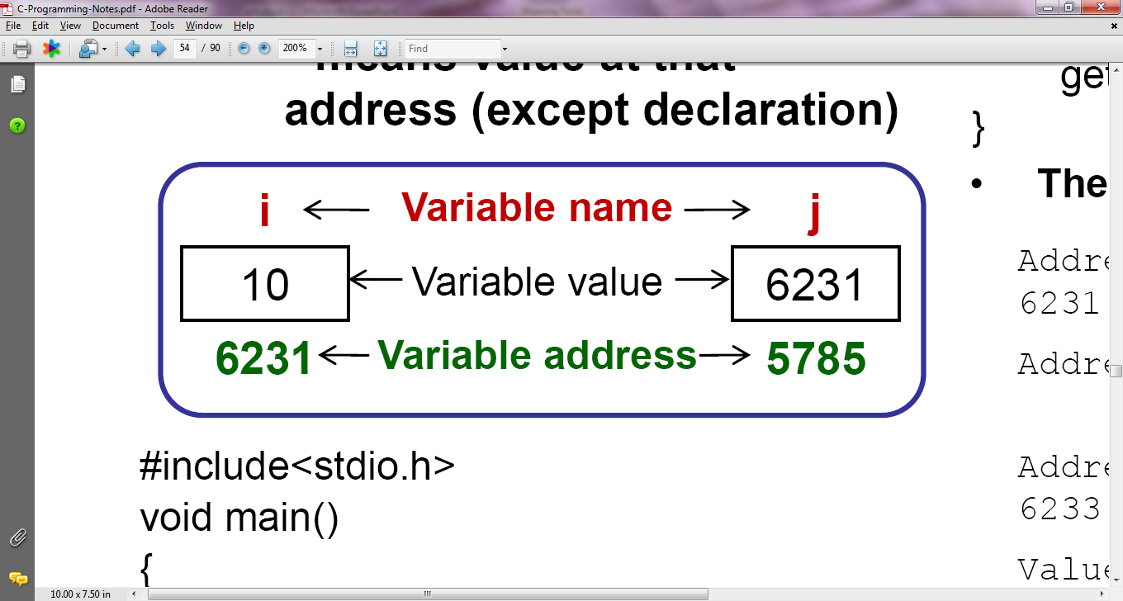
Pointers
Pointer is a variable which can store address of another variable.
& = means address of
* = means value at that address (except declaration)
#include<stdio.h>
void main()
{
int i= 10, *j;
j = &i;
printf("\nAddress of i= %u", &i);
printf("\nAddress of i= %u", j);
printf("\nAddress of j = %u",&j);
printf("\nValue of j = %u", j);
printf("\nValue of i = %d", i);
printf("\nValue of i = %d", *(&i));
printf("\nValue of i = %d", *j);
}
The output of above program:
Address of i = 6231
Address of i= 6231
Address of j = 6233
Value of j = 6231
Value of i = 10
Value of i = 10
Value of i = 10

Slide 68
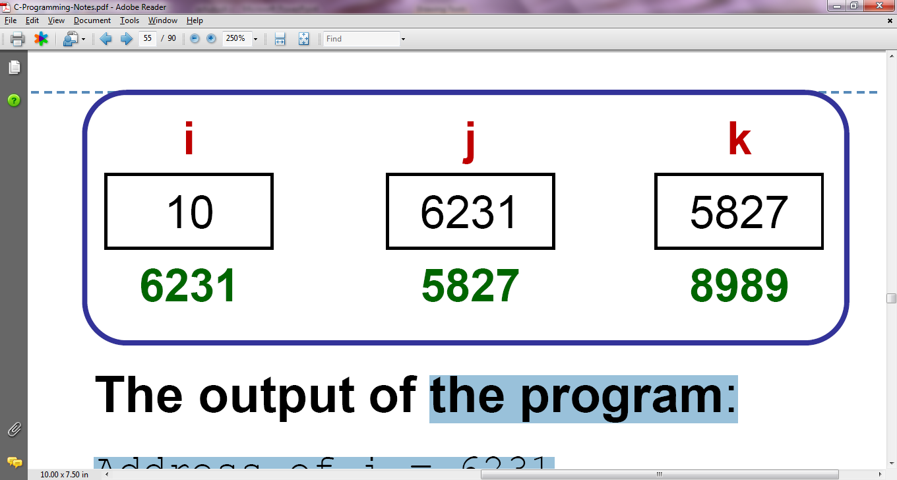
Pointers
The output of above program:
Address of i = 6231
Address of i = 6231
Address of i = 6231
Address of j = 6233
Address of j = 6233
Address of k =6235
Value of j = 6231
Value of k = 6233
Value of i = 10
Value of i = 10
Value of i = 10
Value of i = 10
#include<stdio.h>
void main()
{
int i = 10, *j, **k;
j = &i;
k = &j;
printf("\nAddress of i = %u", &i);
printf("\nAddress of i = %u", j);
printf("\nAddress of i = %u", *k);
printf("\nAddress of j = %u", &j);
printf("\nAddress of j = %u", k);
printf("\nAddress of k = %u", &k);
printf("\nValue of j = %u", j);
printf("\nValue of k = %u, k);
printf("\nValue of i = %d", i);
printf("\nValue of i = %d", *(&i));
printf("\nValue of i = %d", *j);
printf("\nValue of i = %d", **k);
}

Slide 69
Call By Reference Functions
We have already seen the call by value type of functions. The disadvantage of call by value is you can return only one value and only once.
To overcome the disadvantage of call by value we can use call by reference type of functions.
When you pass address of a variable to function that time the function is called as call by reference.
In the below example though we have not returned the value back to calling function, we get the value back to sum variable due to pointer.
#include<stdio.h>
void calsum(int, int, int *);
void main()
{
int no1, no2, sum;
printf("\nEnter two numbers:");
scanf("%d%d", &no1, &no2);
calsum(no1, no2, &sum);
printf("\nSum = %d");
}
void calsum(int x, int y, int *add)
{
*add = x + y;
}

Slide 70
Recursive Functions
You can give a call to a function from the same function it is called as recursive function.
#include<stdio.h>
int factorial(int );
void main()
{
int no, fact;
printf("\nEnter any number: ");
scanf("%d", &no);
fact = factorial(no);
printf("\nThe factorial is: %d", fact);
}
int factorial (int no)
{
int f;
if( no == 1)
return(1);
else
f = no * factorial (no –1);
return(f);
}
Make sure that the recursive call is conditional. An unconditional recursive call will result to a infinite call.

Slide 71
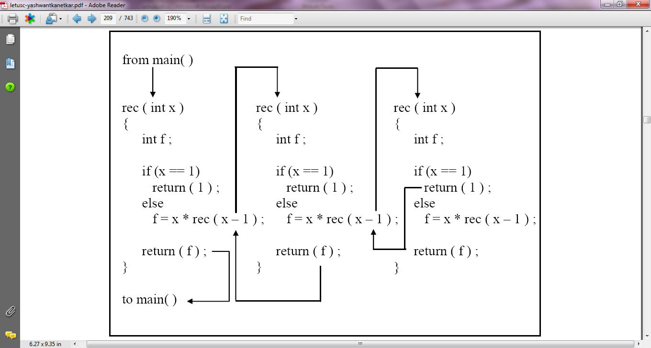
Working of Recursive Functions

Slide 72
Program using Function
Write a general-purpose function to convert any given year into its roman equivalent. The following table shows the roman equivalents of decimal numbers:
Example:
Roman equivalent of 1988 is mdcccclxxxviii
Roman equivalent of 1525 is mdxxv
Write a function that receives 5 integers and returns the sum, average and standard deviation of these numbers. Call this function from main( ) and print the results in main( ).
Write a function that receives marks received by a student in 3 subjects and returns the average and percentage of these marks. Call this function from main( ) and print the results in main( ).
Write a recursive function to obtain the running sum of first 25 natural numbers.
If the lengths of the sides of a triangle are denoted by a, b, and c, then area of triangle is given by
area = √ S(S − a)(S − b)(S − c)
where, S = ( a + b + c ) / 2
Decimal | Roman | Decimal | Roman
1 | i | 100 | c
5 | v | 500 | d
10 | x | 1000 | m
50 | l

Slide 73
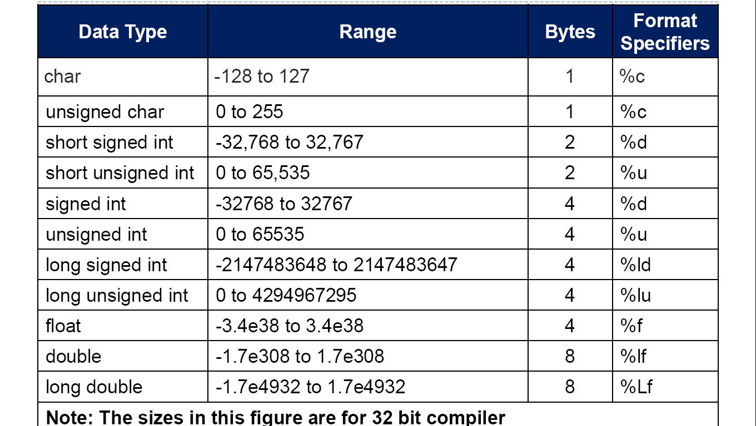
Data Types Revisited

Slide 74
Storage Classes in C
Not only do all variables have a data type, they also have a ‘storage class’. If we don’t specify the storage class of a variable in its declaration, the compiler will assume a storage class depending on the context in which the variable is used.
From C compiler’s point of view, a variable name identifies some physical location within the computer where the string of bits representing the variable’s value is stored. There are basically two kinds of locations in a computer where such a value may be kept— Memory and CPU registers.
A variable’s storage class tells us:
Where the variable would be stored.
What will be the initial value of the variable, if initial value is not specifically assigned.(i.e. the default initial value).
What is the scope of the variable; i.e. in which functions the value of the variable would be available.
What is the life of the variable; i.e. how long would the variable exist.
There are four storage classes in C:
Automatic storage class
Register storage class
Static storage class
External storage class

Slide 75
Automatic Storage Class
main( )
{
auto int i = 1 ;
{
auto int i = 2 ;
{
auto int i = 3 ;
printf ( "\n%d ", i ) ;
}
printf ( "%d ", i ) ;
}
printf ( "%d", i ) ;
}
The output of the above program would be:
3 2 1
The features of a variable defined to have an automatic storage class are as under:
Storage − Memory.
Default initial value − An unpredictable value, which is often called a garbage value.
Scope − Local to the block in which the variable is defined.
Life − Till the control remains within the block in which the variable is defined.
Note that the keyword for this storage class is auto, and not automatic.

Slide 76
Register Storage Class
main( )
{
register int i ;
for ( i = 1 ; i <= 10 ; i++ )
printf ( "\n%d", i ) ;
}
Note:- we cannot say for sure that the value of i would be stored in a CPU register. Why? Because the number of CPU registers are limited, and they may be busy doing some other task. What happens in such an event... the variable works as if its storage class is auto.
Not every type of variable can be stored in a CPU register. if the microprocessor has 16-bit registers then they cannot hold a float value or a double value.
The features of a variable defined to be of register storage class are as under:
Storage - CPU registers.
Default initial value - Garbage value.
Scope - Local to the block in which the variable is defined.
Life - Till the control remains within the block in which the variable is defined.

Slide 77
Static Storage Class
main( ) { increment( ) ; increment( ) ; increment( ) ; } increment( ) { auto int i = 1 ; printf ( "%d\n", i ) ; i = i + 1 ; }
Output:-
1 1 1
main( ) { increment( ) ; increment( ) ; increment( ) ; } increment( ) { static int i = 1 ; printf ( "%d\n", i ) ; i = i + 1 ; }
Output:-
1 2 3
The features of a variable defined to have a static storage class are as under:
Storage − Memory.
Default initial value − Zero.
Scope − Local to the block in which the variable is defined.
Life − Value of the variable persists between different function calls.

Slide 78
External Storage Class
int i ;
main( ){
printf ( "\ni = %d", i ) ;
increment( ) ;
increment( ) ;
decrement( ) ;
decrement( ) ;
}
increment( ){
i = i + 1 ;
printf ( "\non incrementing i = %d", i ) ;
}
decrement( ){
i = i - 1 ;
printf ( "\non decrementing i = %d", i ) ;
}
The output would be:
i = 0
on incrementing i = 1
on incrementing i = 2
on decrementing i = 1
on decrementing i = 0
The features of a variable whose storage class has been defined as external are as follows:
Storage − Memory.
Default initial value − Zero.
Scope − Global.
Life − As long as the program’s execution doesn’t come to an end.

Slide 79
Which to Use When
We can make a few ground rules for usage of different storage classes in different programming situations with a view to:
economize the memory space consumed by the variables
improve the speed of execution of the program
The rules are as under:
Use static storage class only if you want the value of a variable to persist between different function calls.
Use register storage class for only those variables that are being used very often in a program. Reason is, there are very few CPU registers at our disposal and many of them might be busy doing something else. Make careful utilization of the scarce resources. A typical application of register storage class is loop counters, which get used a number of times in a program.
Use extern storage class for only those variables that are being used by almost all the functions in the program. This would avoid unnecessary passing of these variables as arguments when making a function call. Declaring all the variables as extern would amount to a lot of wastage of memory space because these variables would remain active throughout the life of the program.
If you don’t have any of the express needs mentioned above, then use the auto storage class. In fact most of the times we end up using the auto variables, because often it so happens that once we have used the variables in a function we don’t mind loosing them.

Slide 80
C Preprocessor
There are several steps involved from the stage of writing a C Program to the stage of getting it executed. The combination of these steps is known as the 'Build Process'.
Before the C Program is compiled it is passed through another program called as 'Preprocessor'.
C program is often known as 'Source Code'. The Preprocessor works on Source Code and creates 'Expanded Source Code'.
If source file is Prog01.C, the expanded source code is stored in file Prog01.I. The expanded source code is sent for compilation.
The preprocessor directives begin with # symbol. Generally they are placed at the start of the program, before function definitions.
Following are the preprocessor directives –
Macro Expansion
Simple Macros
Macros with Arguments
File Inclusion
Conditional Compilation
Miscellaneous Directives

Slide 81
C Preprocessor
Macro Expansion
#define PI 3.142
The above expression is called as 'macro definition'. During the preprocessing PI will be replaced with 3.142.
PI in above example is called as 'macro template' and 3.142 is called as 'macro expansion'.
When we compile the program, before the source code passes to the compiler, it is examined by C preprocessor for macro definitions. And when it finds the macro templates they replace it with appropriate macro expansion.
Some examples –
#define AND &&
We can use AND instead of &&
#define OR ||
We can use OR instead of ||
#define RANGE ( a > 25 && a < 50)
We can use RANGE instead of (a>25 && a < 50)
#define FOUND printf("Location Found");
We can use FOUND instead of printf("Location Found")

Slide 82
Macros with Arguments
We can pass arguments to macros.
#include<stdio.h>
#define AREA(x) (3.142 * x * x)
void main()
{
float r = 5.25, a;
a = AREA(r);
printf("\nThe area is : %f", a);
}
When the above code is passed to preprocessor –
a = AREA(r);
will get converted to –
a = 3.142 * r * r;
Multiline Macros
Macros can be split into multiple lines with a '\' (back slash) present at the end of each line.
#include<stdio.h>
#define HLINE for(i=0; i<79; i++) \
printf("%c", 196);
#define VLINE(X, Y) { \
gotoxy(X, Y); \
printf("%c", 179); }
void main()
{
int i, y;
gotoxy(1, 12);
HLINE;
for (y = 1; y < 25; y++)
VLINE(39, y);
}

Slide 83
File Inclusion
This preprocessor directive allows us to include one file into other.
The large programs can be divided into different files, each containing a set of functions. These files can be included at the beginning of main program file.
The files to be included should have .h extension. This extension stands for a 'header file'.
Each header file generally contains related set of functions.
e.g. math.h will contain all functions related to mathematics.
You can include these files into main using #include statement.
#include "filename"
#include<filename>
#include "filename" will search filename into current directory as well as specified list of directories mentioned in the include search path.
•#include <filename> will search the filename into specified list of directories only.

Slide 84
Some more preprocessor
We can make use of various preprocessor directives such as
#ifdef - #else - #endif, #if and #elif in our program.
The directives like #undef and #pragma are also useful although they are seldom used.
#if ADAPTER == VGA code for video graphics array #elif ADAPTER == SVGA code for super video graphics array #else code for extended graphics adapter #endif | void fun1( ) ; void fun2( ) ; #pragma startup fun1 #pragma exit fun2 main( ) { printf ( "\nInside maim" ) ; } void fun1( ) { printf ( "\nInside fun1" ) ; } void fun2( ) { printf ( "\nInside fun2" ) ; }

Slide 85
Compilation of Program
Source Code( .c or .cpp)
g++ hello.cpp
g++ -o hello hello.cpp
Preprocessing
a.out (Linux) or a.exe(Windows)
Step1: Preprocessor
Expanded Code file( .i or .ii)
Hello.cpp
Compilation
Step2: Compiler
Assembly Code( .s)
Assemble
Step3: Assembler
Compiler
Machine Code ( .o or .obj)
Library(.lib or .a)
Linking
Step4: Linker
Binary File
Executable Code( .out or .exe)

Slide 86
The Build Process
Preprocessing: The C code is expanded on preprocessor directives like #define, #include etc.
gcc –E demo.c > demo.i
Compilation: If expanded source code is error free then compiler translates the expanded source code into equivalent assembly language program.
gcc –S demo.c
Assembling: The job of Assembler is to translate .asm code into relocatable object code. Thus a .asm file gets converted to .obj file.
gcc –c demo.c
Linking: Linking creates an executable program. It finds the definitions of all external functions, finds definitions of all global variables, combines data sections into a single data section and combines code sections into single code section. And finally .exe file is created.
gcc filename(.c or .o)
C Source Code
Prog1.c
Expanded Source Code
Prog1.i
Assembly Code
Prog1.asm(.s)
Relocatable Object Code
Prog1.o
Object Code of Library Function
Executable Code
Prog1.exe

Slide 87
Programs using macro
Write down macro definitions for the following:
To test whether a character entered is a small case letter or not.
To test whether a character entered is a upper case letter or not.
To test whether a character is an alphabet or not. Make use of the macros you defined in (1) and (2) above.
To obtain the bigger of two numbers.
Write macro definitions with arguments for calculation of area and perimeter of a triangle, a square and a circle. Store these macro definitions in a file called “areaperi.h”. Include this file in your program, and call the macro definitions for calculating area and perimeter for different squares, triangles and circles.
Write down macro definitions for the following:
To find arithmetic mean of two numbers.
To find absolute value of a number.
To convert a uppercase alphabet to lowercase.
To obtain the bigger of two numbers.
Write macro definitions with arguments for calculation of Simple Interest and Amount. Store these macro definitions in a file called “interest.h”. Include this file in your program, and use the macro definitions for calculating simple interest and amount.

Slide 88
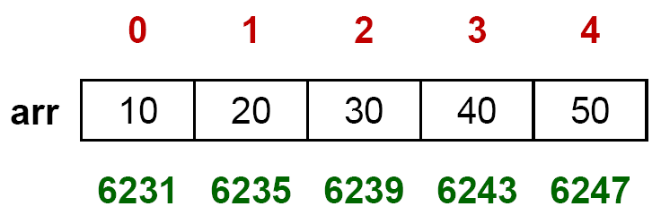
Arrays
Array is a collection of variables of same data type.
E.g. if we want to store roll numbers of 100 students, then you have to define 100 variables and which is very difficult to manage. Instead you can define one array which can hold 100 variables.
Declare Array:
int arr[5];
intarr[5] = {10,20,30,40,50};
int arr[ ] = {10,20,30,40,50};
When you declare an array a consecutive memory allocation is done for 5 integers.
You can initialize the array only at the time of declaration.
Array index always starts from zero.
If you want to refer array elements you can use arr[0], arr[1], arr[2] etc.
In the following array 10 is a value at array index 0 having address 6231.
Memory Map of Array:

Slide 89
Arrays
As array holds multiple locations you have to use for loop while accepting and printing the array.
You can define an array of bigger size and accept the required no. of values from user. e.g. you can define an array of arr[100] and use only 10 locations.
In C Language the bounds checking for array is not done. So the programmer has to be very careful while accepting or printing the values from array.
Accept and Print Array:
#include<stdio.h>
void main()
{
int arr[5], i;
printf("\nEnter five numbers: ");
for(i = 0; i < 5; i++)
scanf("%d", &arr[i]);
printf("\nYou have entered: ");
for(i = 0; i < 5; i++)
printf(" %d", arr[i]);
}

Slide 90
Array And Pointer
Output:-
address = 1439576 1439576 element = 24 24 24 24
address = 1439580 1439580 element = 34 34 34 34
address = 1439584 1439584 element = 12 12 12 12
address = 1439588 1439588 element = 44 44 44 44
address = 1439592 1439592 element = 56 56 56 56
address = 1439596 1439596 element = 17 17 17 17
main( )
{
int num[ ] = { 24, 34, 12, 44, 56, 17 } ;
int i ;
for ( i = 0 ; i <= 5 ; i++ )
{
printf ( "\naddress = %u %u ", &num[i], num+i) ;
printf ( "element = %d %d ", num[i], *( num + i ) ) ;
printf ( "%d %d", *( i + num ), i[num] ) ;
}
}

Slide 91
Passing Array to a Function
#include<stdio.h>
void display(int [ ], int);
void main()
{
int arr[5], i;
printf("Enter five numbers: ");
for(i = 0; i < 5; i++)
scanf("%d", &arr[i]);
display(arr, 5);
}
void display (int a[ ], int s)
{
int i;
printf("\nYou have entered: ");
for(i = 0; i < s; i++)
printf(" %d", a[i]);
}

Slide 92
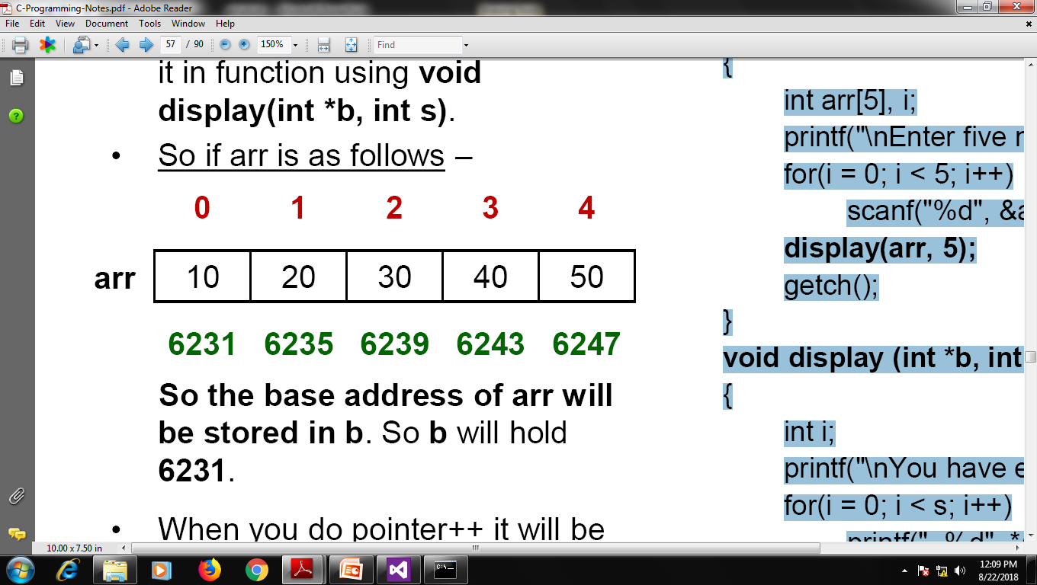
Passing Array to Function using Pointers
#include<stdio.h>
void display (int *, int);
void main()
{
int arr[5], i;
printf("\nEnter five numbers: ");
for(i = 0; i < 5; i++)
scanf("%d", &arr[i]);
display(arr, 5);
}
void display (int *b, int s)
{
int i;
printf("\nYou have entered: ");
for(i = 0; i < s; i++)
printf(" %d", *(b+i));
}
When we want to pass the array to function using pointers we pass it as display(arr, size) and catch it in function using void display(int *b, int s).
So if arr is as follows–
So the base address of arr will be stored in b. So b will hold 6231.
When you do pointer++ it will be increased by no. of bytes of it's datatype.

Slide 93
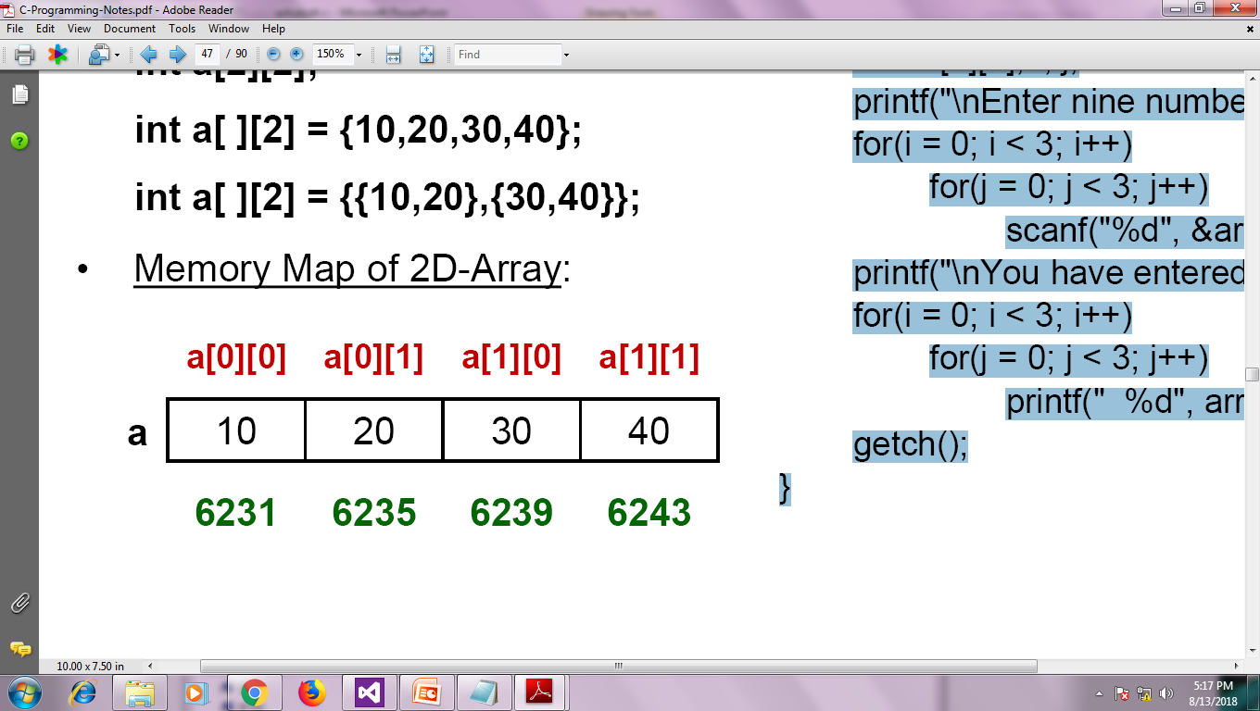
Two Dimensional Arrays
Array can have two or more dimensions.
Declare 2D-Array:
int a[2][2];
int a[ ][2] = {10,20,30,40};
int a[ ][2] = {{10,20},{30,40}};
Memory Map of 2D-Array:
#include<stdio.h>
void main()
{
int arr[3][3], i, j;
printf("\nEnter nine numbers: ");
for(i = 0; i < 3; i++)
for(j = 0; j < 3; j++)
scanf("%d", &arr[i][j]);
printf("\nYou have entered: ");
for(i = 0; i < 3; i++)
for(j = 0; j < 3; j++)
printf(" %d", arr[i][j]);
}

Slide 94
2D Array And Pointer
address = 2293168 2293168 2293168 element = 24 24 24
address = 2293172 2293172 2293172 element = 34 34 34
address = 2293176 2293176 2293176 element = 12 12 12
address = 2293180 2293180 2293180 element = 44 44 44
address = 2293184 2293184 2293184 element = 56 56 56
address = 2293188 2293188 2293188 element = 17 17 17
main( )
{
int num[3][2] = { 24, 34, 12, 44, 56, 17 } ;
int i, j, col=2;
for ( i = 0 ; i < 3 ; i++ )
for( j=0 ; j < 2 ; j++ )
{
printf ( "address = %u %u %u ", &num[i][j], *(num+i)+j, *num + i * col + j) ;
printf ( "element = %d %d %d", num[i][j], *(*( num + i )+j), *(*num + i * col + j) ) ;
}
}

Slide 95
Passing 2D-Array to a Function
#include<stdio.h>
void display(int [ ][3], int, int);
void main()
{
int arr[3][3], i, j;
printf("\nEnter nine numbers: ");
for(i = 0; i < 3; i++)
for(j = 0; j < 3; j++)
scanf("%d", &arr[i][j]);
display(arr, 3, 3);
}
void display (int a[ ][3], int r, int c)
{
int i, j;
printf("\nYou have entered: ");
for(i = 0; i < r; i++)
for(j = 0; j < c; j++)
printf(" %d", a[i][j]);
}

Slide 96
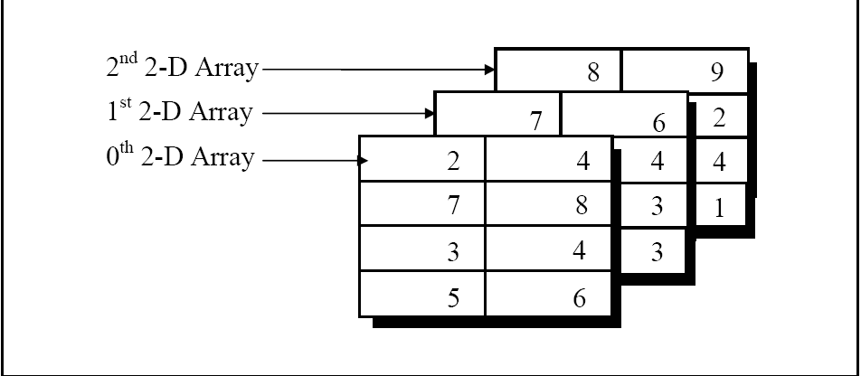
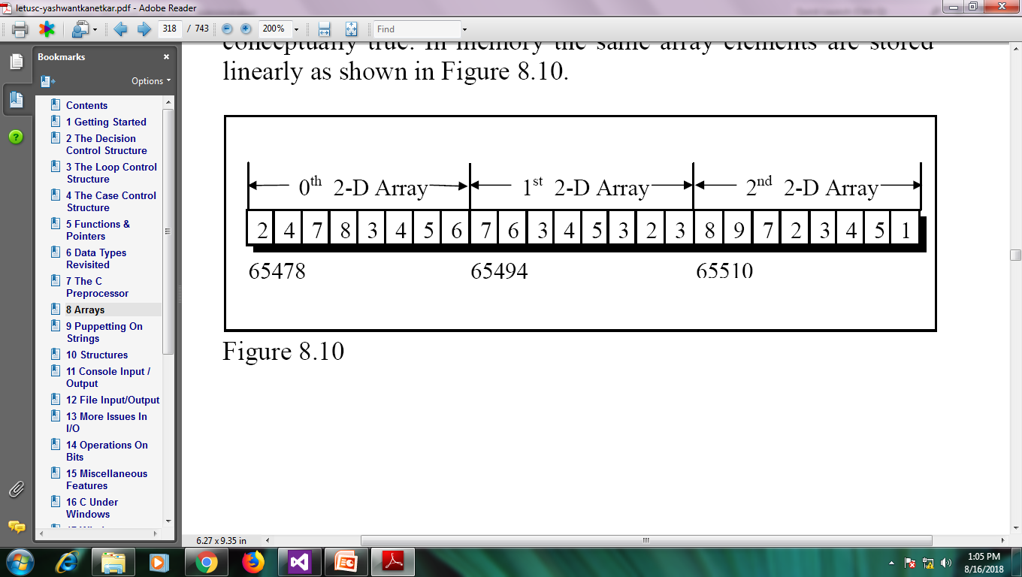
Three-Dimensional Array
int arr[3][4][2] = {
{
{ 2, 4 },
{ 7, 8 },
{ 3, 4 },
{ 5, 6 }
},{
{ 7, 6 },
{ 3, 4 },
{ 5, 3 },
{ 2, 3 }
},{
{ 8, 9 },
{ 7, 2 },
{ 3, 4 },
{ 5, 1 },
}
} ;
remember that the arrangement shown above is only conceptually true. In memory the same array elements are stored linearly.
arr[0][1][1]
*( *( *( arr + 0 ) + 1 ) + 1 )

Slide 97
Accepting and printing element of 3D Array
#include <stdio.h>
void main()
{
int i, j, k, test[2][3][2];
printf("Enter 12 values: \n");
for(i = 0; i < 2; ++i)
for (j = 0; j < 3; ++j)
for(k = 0; k < 2; ++k )
scanf("%d", &test[i][j][k]);
printf("\nDisplaying values:\n");
for(i = 0; i < 2; ++i)
for (j = 0; j < 3; ++j)
for(k = 0; k < 2; ++k )
printf("test[%d][%d][%d] = %d\n", i, j, k, test[i][j][k]);
}
Enter 12 values: 1 2 3 4 5 6 7 8 9 10 11 12
Displaying Values:
test[0][0][0] = 1
test[0][0][1] = 2
test[0][1][0] = 3
test[0][1][1] = 4
test[0][2][0] = 5
test[0][2][1] = 6
test[1][0][0] = 7
test[1][0][1] = 8
test[1][1][0] = 9
test[1][1][1] = 10
test[1][2][0] = 11
test[1][2][1] = 12

Slide 98
Program using Function
Twenty-five numbers are entered from the keyboard into an array. The number to be searched is entered through the keyboard by the user. Write a program to find if the number to be searched is present in the array and if it is present, display the number of times it appears in the array.
Twenty-five numbers are entered from the keyboard into an array. Write a program to find out how many of them are positive, how many are negative, how many are even and how many odd.
Write a C program to Sort array of 25 numbers.

Slide 99
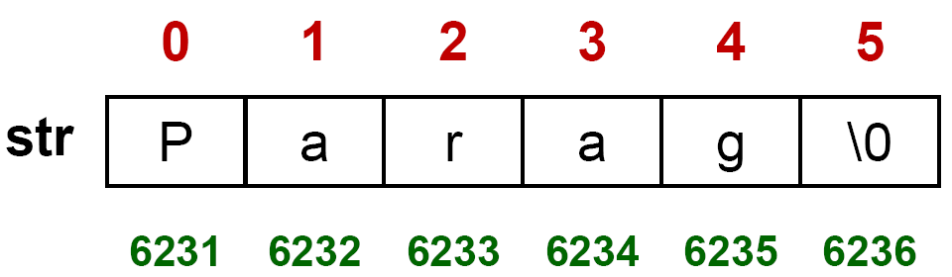
Strings
#include<stdio.h>
void main()
{
char name[50];
int i;
printf("\nEnter your name: ");
scanf("%s", name);
printf("\nYour name is: %s", name);
printf("\nYour name is: ");
for(i = 0; name[i] != '\0'; i++)
printf("%c", name[i]);
}
String is a collection of character variables. Sometimes you need to store name, address where you have to store more than one characters, you need strings.
Declare String:
char s[50];
char s[ ] = {'P','a','r','a','g','\0'};
char s[ ] = "Parag";
Memory Map of a String:
'\0' character is automatically appended at the end while accepting the string.

Slide 100
Strings
%s is special format specifier to accept the strings. But it cannot accept string with spaces. So use gets(string-name) function to accept string.
You can print the string using puts(string-name) function.
You are not needed to accept the size of strings as you require in case of arrays because C automatically appends the '\0' character at the end of the string. Hence you know when a '\0' character appears, that is the end of the string.

Slide 101
Function | Use | Call
strlen | Finds the length of the string | strlen(str1)
strlwr | Converts string to lowercase | strlwr(str1)
strupr | Converts string to uppercase | strupr(str1)
strcpy | Copies string to another string | strcpy(dest,source)
Strncpy | Copies first n characters of one string into another | strncpy(dest,source,4)
Strcat | Appends one string at the end of another string | strcat(dest,source)
strncat | Appends first n characters of a string at the end of Another | strncat(dest,source,4)
strcmp | Compares two string | strcmp(str1,str2)
strncmp | Compares first n characters of two strings | strncmp(str1,str2,4)
strcmpi | Compares two strings without regard to case ("i" denotes that this function ignores case) | strcmpi(str1,str2)
stricmp | Compares two strings without regard to case (identical to strcmpi) | stricmp(str1,str2)
strnicmp | Compares first n characters of two strings without regard to case | strnicmp(str1,str2,4)
strdup | Duplicates a string | strdup(str1)
strchr | Finds first occurrence of a given character in a string | strchr(str1,'s')
strrchr | Finds last occurrence of a given character in a string | strrchr(str1,'s')
strstr | Finds first occurrence of a given string in another string | strstr(str1,"sh")
strset | Sets all characters of string to a given character | strset(str1,'#')
strnset | Sets first n characters of a string to a given character | strnset(str1,'$',3)
strrev | Reverses the string | strrev(str1)

Slide 102
Passing String to Function
#include<stdio.h>
void display(char [ ]);
void main()
{
int name[50], i;
printf("\nEnter your name: ");
gets(name);
display(name);
}
void display (char str[ ])
{
int i;
printf("\nYour name is: %s", str);
printf("\nYour name is: ");
for(i = 0; str[i] != '\0' ; i++)
printf("%c", str[i]);
}
Output:
Enter your name: Rohit
Your name is: Rohit
Your name is: Rohit

Slide 103
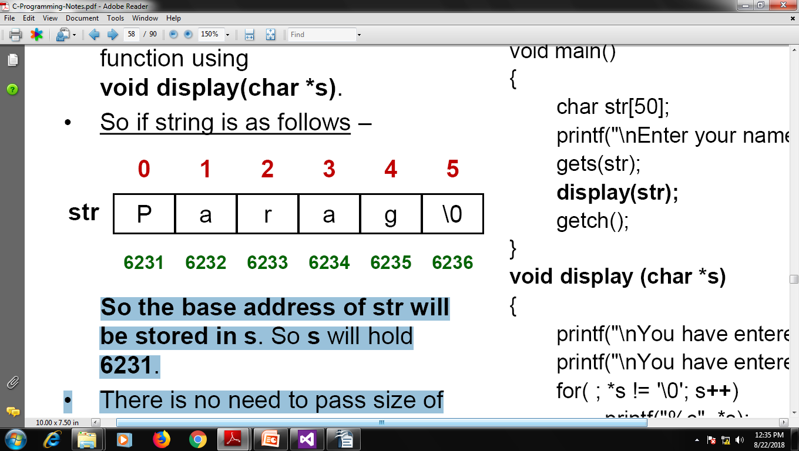
Passing String to Function using Pointers
When we want to pass the string to function using pointers we pass it as display(str) and catch it in function using void display(char *s).
So if string is as follows–
So the base address of str will be stored in s. So swill hold 6231.
There is no need to pass size of the string as the end character of string holds '\0';
#include<stdio.h>
void display (char *);
void main()
{
char str[50];
printf("\nEnter your name: ");
gets(str);
display(str);
}
void display (char *s)
{
printf("\nYou have entered: %s", s);
printf("\nYou have entered: ");
for( ; *s != '\0'; s++)
printf("%c", *s);
}

Slide 104
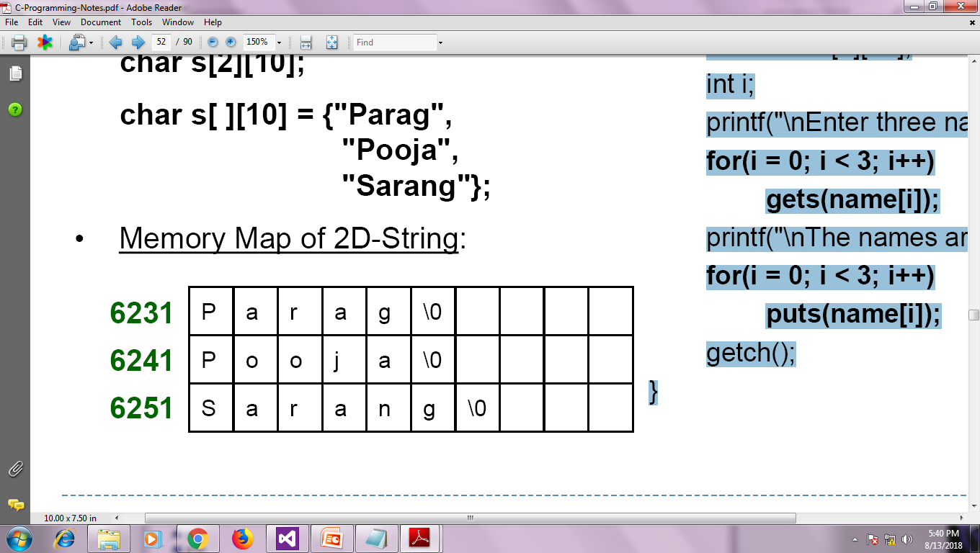
Two Dimensional Strings
#include<stdio.h>
void main()
{
char name[3][50];
int i;
printf("\nEnter three names: ");
for(i = 0; i < 3; i++)
gets(name[i]);
printf("\nThe names are: ");
for(i = 0; i < 3; i++)
puts(name[i]);
}
Strings also can have 2 or more dimensions. When you want to store multiple names, addresses that time you need 2-D string.
Declare 2D-String:
char s[2][10];
char s[ ][10] = {"Parag", "Pooja", "Sarang"};
Memory Map of 2D-String:

Slide 105
Passing 2D-String to a Function
#include<stdio.h>
void display(char [ ][50], int);
void main()
{
char name[3][50];
int i;
printf("\nEnter three names: ");
for(i = 0; i < 3; i++)
gets(name[i]);
display(name, 3);
}
void display (char n[ ][50], int s)
{
int i;
printf("\nThe names are: ");
for(i = 0; i < s; i++)
puts(n[i]);
}

Slide 106
Array of Pointers to Strings(Jagged Array)
main( )
{
char *names[6] ;
int i ;
for ( i = 0 ; i <= 5 ; i++ )
{
printf ( "\nEnter name " ) ;
scanf ( "%s", names[i] ) ;
}
}
The program doesn’t work because; when we are declaring the array it is containing garbage values. And it would be definitely wrong to send these garbage values to scanf( ) as the addresses where it should keep the strings received from the keyboard.
#include "alloc.h"
main( )
{
char *names[5] ;
char n[50] ;
int len, i ;
char *p ;
for ( i = 0 ; i < 3 ; i++ )
{
printf ( "\nEnter name " ) ;
scanf ( "%s", n ) ;
len = strlen ( n ) ;
p = (char *) malloc ( len + 1 ) ;
strcpy ( p, n ) ;
names[i] = p ;
}
for ( i = 0 ; i <= 3 ; i++ )
printf ( "\n%s", names[i] ) ;
}
Runtime Create Array

Slide 107
What Happen in Memory
If user input:-
ashutosh
If user input:-
abc
If user input:-
pqrs
CODE
Static And Global
0 1 2 3 4 5 6 7 8
main
a s h u t o s h \O
names
Stack
12300
0
1
2
3
4
12300
len
i
p
0 1 2 3
3
12350
a b c \O
4
3
8
1
0
2
12300
Heap
12350
12400
12400
12350
n
0 1 2 3 4 5 6 7 8 9 10 …. 50
0 1 2 3 4
p q r s \O
p q r s \O
a b c \O
a s h u t o s h \O
12400

Slide 108
Dynamic Memory Creation
IMP Note:- if we create memory runtime using malloc() or calloc() then it is our responsibility to delete it using free(). Other wise we leak our application data(known as memory leak).
As you know, an array is a collection of a fixed number of values. Once the size of an array is declared, you cannot change it.
Sometimes the size of the array you declared may be insufficient. You may want more or less array size. Run time your not able to change it.
To solve this issue, you can allocate memory manually during run-time.
This is known as dynamic memory allocation in C programming.
To allocate memory dynamically, c provide some library functions. These functions are defined in the <stdlib.h> header file.
They are:
malloc() :- (pointer type) malloc(numbers of byte required); //(char*)malloc(num*sizeof(char));
calloc() :- (pointr)calloc(num, size of each block); // (int*)calloc(num, sizeof(int));
realloc() :- (pointer)realloc(oldPtr, new size in bytes); //(int*)realloc(ptr,100*sizeod(int));
free() :- free(pointer); // free(ptr);
Malloc this function accept number of bytes and create that many byte memory in heap and return void pointer we have to cast it.
Calloc this accept two arguments 1st number of block 2nd size of each block and it will return void pointer you have to cast it.
Realloc is use to re-allocate the memory it accept two arg 1st old array pointer 2nd new increase size.
Free this function is use to delete the allocated memory it accept only one arg that is old ptr which point to array on heap.

Slide 109
Programs for String
Write a following function without using liabrary function.
Strlen
Strcpy
Strcmp
Strlwr
Strstr
Write a program that extracts part of the given string from the specified position. For example, if the sting is "Working with strings is fun", then if from position 4, 4 characters are to be extracted then the program should return string as "king". Moreover, if the position from where the string is to be extracted is given and the number of characters to be extracted is 0 then the program should extract entire string from the specified position.
Write a program that replaces two or more consecutive blanks in a string by a single blank. For example, if the input is
Grim return to the planet of apes!!
the output should be
Grim return to the planet of apes!!
Write a program to delete all vowels from a sentence. Assume that the sentence is not more than 80 characters long.
Write a program to count the number of occurrences of any two vowels in succession in a line of text. For example, in the sentence
“Pleases read this application and give me gratuity”
such occurrences are ea, ea, ui.

Slide 110
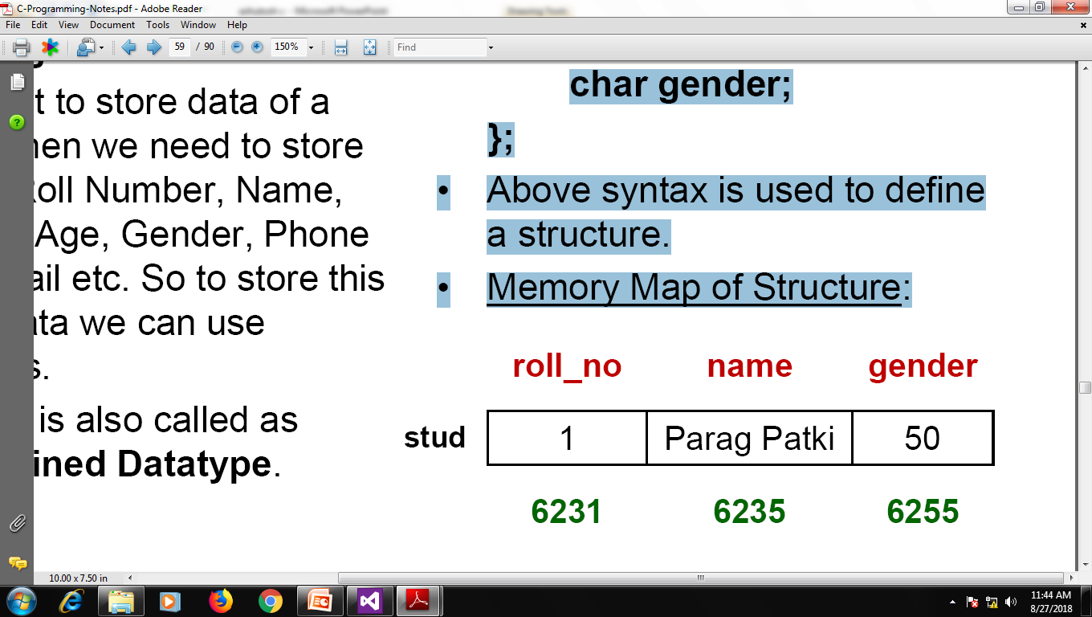
Structures
If we see real world data it is a combination of integers, characters, floats, arrays, strings etc. So we can call it as a heterogeneous data.
If we want to store data of a student then we need to store her/ his Roll Number, Name, Address, Age, Gender, Phone No., E-mail etc. So to store this kind of data we can use structures.
Structure is also called as User Defined Datatype.
struct stud
{
int roll_no;
char name[20];
char gender;
};
Above syntax is used to define a structure.
Memory Map of Structure:

Slide 111
Structures
#include<stdio.h>
struct stud
{
int roll_no;
char name[50], address[100];
char gender;
};
void main()
{
struct stud s;
printf("\nEnter roll number:");
scanf("%d", &s.roll_no);
printf("\nEnter name: ");
flushall( );
gets(s.name);
printf("\nEnter address: ");
flushall();
gets(s.address);
printf("\nEnter gender <y/n>: ");
flushall( );
scanf("%c", &s.gender);
printf("\nRoll No. is: %d", s.roll_no);
printf("\nName is: %s", s.name);
printf("\nAddress is: %s", s.address);
printf("\nGender is: %c", s.gender);
}

Slide 112
Nested Structures
scanf("%d", &e.p.roll_no);
printf("\nEnter Name: ");
flushall( );
gets(e.p.name);
printf("\nEnter Gender <y/n>: ");
flushall( );
scanf("%c", &e.p.gender);
printf("\nEnter E-mail: ");
flushall( );
gets(e.p.email);
printf("Enter marks of three subjects:");
scanf("%d%d", &e.m1, &e.m2);
printf("\nName = %s", e.p.name);
printf("\nRoll No. = %d", e.p.roll_no);
printf("\nGender = %c", e.p.gender);
printf("\nEmail = %s", e.p.email);
printf("Marks = %d %d", e.m1, 2.m2);
}
#include<stdio.h>
struct p_details
{
int roll_no;
char name[50];
char gender;
char email[50];
};
struct e_student
{
int m1, m2;
struct p_details p;
};
void main()
{
struct e_student e;
printf("\nEnterroll number:");

Slide 113
Array of Structures
for(i=0; i<size; i++)
{
printf("\nEnter roll no.:");
scanf("%d", &s[i].roll_no);
printf("\nEnter Name: ");
flushall( );
gets(s[i].name);
printf("\nEnter marks:");
scanf("%d%d", &s[i].m1, s[i].m2);
}
printf("\n\n\nRecords are:");
for(i=0; i<size; i++)
{
printf("\nRoll no.: %d", s[i].roll_no);
printf("\nName: %s", s[i].name);
printf("\nMarks:%d %d", s[i].m1, s[i].m2);
}
}
#include<stdio.h>
struct student
{
int roll_no;
char name[50];
int m1, m2;
};
typedef struct student STUD;
void main()
{
STUD s[50];
int i, size;
printf("\nEnter no. of records: ");
scanf("%d", &size);
printf("\nEnter %d records:", size);

Slide 114
Passing Structure to Function
#include<stdio.h>
typedef struct stud
{
int roll_no;
char name[50];
int m1, m2;
}STUD;
void display(STUD);
void main( )
{
STUD s;
printf("\nEnter Roll Number: ");
scanf("%d", &s.roll_no);
printf("\nEnter Name: ");
flushall( );
gets(s.name);
printf("\nEnter Marks:");
scanf("%d%d", &s.m1, &s.m2);
display(s);
}
void display(STUD s1)
{
printf("\nRoll No.: %d", s1.roll_no);
printf("\nName: %s", s1.name);
printf("\nMarks: %d %d", s1.m1, s1.m2);
}

Slide 115
Passing Array of Structures to Function
#include<stdio.h>
struct stud
{
int roll_no;
char name[50];
int m1, m2;
};
void display(struct stud[ ] );
void main( )
{
Int i;
struct stud s[5];
for(i=0;i<5;i++)
{
printf("\nEnter Roll Number: ");
scanf("%d", &s[i].roll_no);
printf("\nEnter Name: ");
flushall( );
gets(s[i].name);
printf("\nEnter Marks:");
scanf("%d%d", &s[i].m1, &s[i].m2);
}
display(s);
}
void display(struct stud s1[ ])
{
for(int i=0;i<5;i++)
{
printf("\nRoll No.: %d", s1[i].roll_no);
printf("\nName: %s", s1[i].name);
printf("\nMarks: %d %d", s1[i].m1, s1[i].m2);
}
}

Slide 116
Structure to Pointer
#include<stdio.h>
struct stud
{
int roll_no;
char name[50];
int m1, m2;
};
void display(struct stud *);
void main( )
{
struct stud s;
printf("\nEnter Roll Number: ");
scanf("%d", &s.roll_no);
printf("\nEnter Name: ");
flushall( );
gets(s.name);
printf("\nEnter Marks:");
scanf("%d%d", &s.m1, &s.m2);
display(&s);
}
void display(struct stud *s1)
{
printf("\nRoll No.: %d", s1->roll_no);
printf("\nName: %s", s1->name);
printf("\nMarks: %d %d", s1->m1, s1->m2);
}

Slide 117
Passing Array of Structures to Pointer
#include<stdio.h>
struct stud
{
int roll_no;
char name[50];
};
void display(struct stud *, int);
void main()
{
struct stud s[3];
int i;
printf("\nEnter 3 records: \n\n");
for(i=0; i<3; i++)
{
printf("\nEnter roll no.: ");
scanf("%d", &s[i].roll_no);
printf("\nEnter Name: ");
flushall();
gets(s[i].name);
printf("\n\n");
}
display(s,3);
}
void display(struct stud *s1, int n)
{
int i;
printf("\nYou have entered: \n\n");
for(i=0; i<n; i++, s1++)
{
printf("\nEnter roll no.: %d", s1->roll_no);
printf("\nEnter Name: %s", s1->name);
}
}

Slide 118
Programs on structure
Create a structure to specify data on students given below:Roll number, Name, Department, Course, Year of joining Assume that there are not more than 450 students in the collage.
Write a function to print names of all students who joined in a particular year.
Write a function to print the data of a student whose roll number is given.
Write a menu driven program that depicts the working of a library. The menu options should be:
Add book information
Display book information
List all books of given author
List the title of specified book
List the count of books in the library
List the books in the order of accession number
Exit
Create a structure called library to hold accession number, title of the book, author name, price of the book, and flag indicating whether book is issued or not.

Slide 119
Input / Output in C
There are two types of I/O.
Console I/O
File I/O
When we say Input, it means to feed some data into a program. An input can be given in the form of a file or from the command line. C programming provides a set of built-in functions to read the given input and feed it to the program as per requirement.
When we say Output, it means to display some data on screen, printer, or in any file. C programming provides a set of built-in functions to output the data on the computer screen as well as to save it in text or binary files.

Slide 120
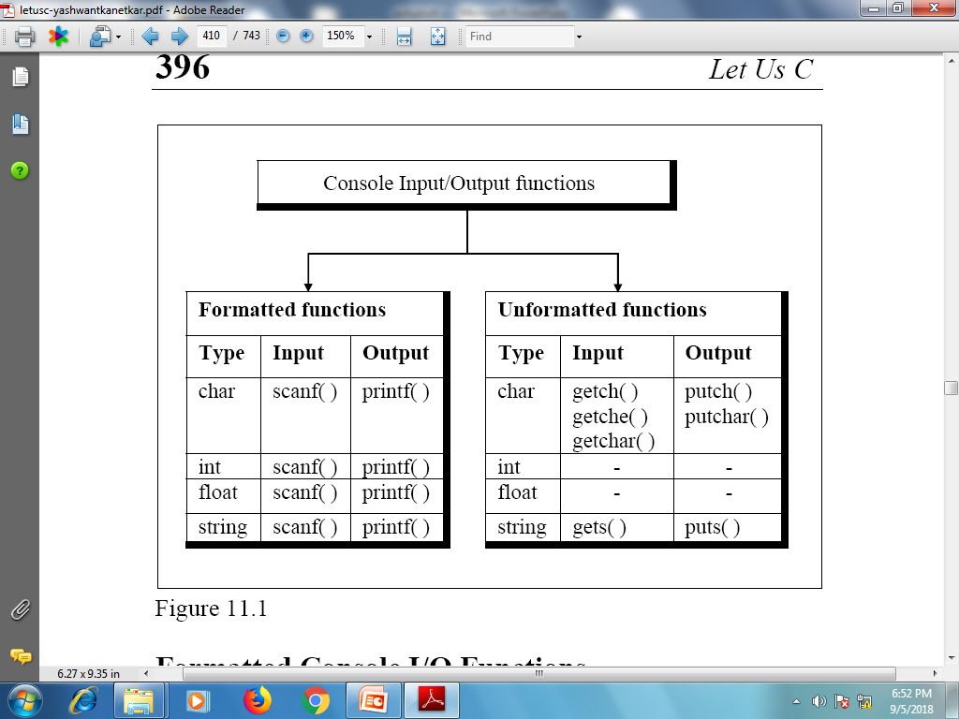
Console I/O

Slide 121
Unformatted Function
#include <stdio.h>
int main( )
{
int c; char str[100];
printf( "Enter a value :");
c = getchar( );
printf( "\nYou entered: ");
putchar( c );
printf( "Enter a value :");
gets( str );
printf( "\nYou entered: ");
puts( str );
return 0;
}
The int getchar(void) function reads the next available character from the screen and returns it as an integer. This function reads only single character at a time. You can use this method in the loop in case you want to read more than one character from the screen.
The int putchar(int c) function puts the passed character on the screen and returns the same character. This function puts only single character at a time. You can use this method in the loop in case you want to display more than one character on the screen.
The char *gets(char *s) function reads a line from stdin into the buffer pointed to by s until either a terminating newline or EOF (End of File).
The int puts(const char *s) function writes the string 's' and 'a' trailing newline to stdout.

Slide 122
Formatted Function
#include <stdio.h>
int main( )
{
char str[100];
int i; float f;
printf( "Enter a value :");
scanf("%s %d %f", str, &i ,&f);
printf("\nYou entered:%20s %8d %6.2f",str, i, f);
return 0;
}
The int scanf(const char *format, ...) function reads the input from the standard input stream stdin and scans that input according to the format provided.
The int printf(const char *format, ...) function writes the output to the standard output stream stdout and produces the output according to the format provided.
The format can be a simple constant string, but you can specify %s, %d, %c, %f, etc., to print or read strings, integer, character or float respectively. There are many other formatting options available which can be used based on requirements.

Slide 123
File I/O
Till now whatever programs we have seen, in those programs data vanishes when the program ends. So to store the data on the disk we need file I/O operations.
All the data on the disk is stored in binary form. But the process of storing data varies from OS to OS. The programmer uses library function in a particular OS to perform I/O.
There are different operations that can be carried out on the file:
Creation of new file
Opening an existing file
Reading from a file
Writing to a file
Moving to a specific location in the file
Closing a file

Slide 124
Display Contents of File on Console
#include<stdio.h>
#include<stdlib.h>
void main( )
{
FILE *fp;
char ch;
fp = fopen("Source.txt", "r");
if(fp == NULL)
{
puts("Cannot open source file");
exit(1);
}
while(1)
{
ch = fgetc(fp);
if(ch == EOF)
break;
printf("%c", ch);
}
fclose(fp);
}
FILE is a inbuilt structure defined in stdio.h header file.
fopen() function searches the file on disk to be opened, if file found it loads it into buffer and it sets up a character pointer that points to the first character of buffer. If file not found it returns NULL.
exit() function terminates the program.
while(1) is a infinite loop.
fgetc(fp) function returns the character present at the pointer fp and moves the pointer to the next location.
EOF stands for End Of File character which indicates the end of file.
fclose() function closes the file.

Slide 125
Writing From One File to Another
#include<stdio.h>
#include<stdlib.h>
void main( )
{
FILE *fs, *ft;
char ch;
fs = fopen("Source.txt", "r");
if(fs == NULL)
{
puts("Cannot open source file");
exit(1);
}
ft = fopen("Target.txt", "w");
if(ft == NULL)
{
puts("Cannot open target file");
fclose(fs);
exit(2);
}
while(1)
{
ch = fgetc(fs);
if(ch == EOF)
break;
else
fputc(ch, ft);
}
fclose(fs);
fclose(ft);
printf("File copied successfully");
}
fputc(ch, ft) writes the character ch to the file location ft and moves pointer ahead to next location.

Slide 126
Writing String Received From Keyboard to File
#include<stdio.h>
#include<string.h>
#include<stdlib.h>
void main( )
{
FILE *fp;
char s[80];
fp = fopen("Target.txt", "w");
if(fp == NULL)
{
puts("Cannot open file");
exit(1);
}
printf("\nEnter few lines: ");
while(strlen(gets(s)) > 0)
{
fputs(s, fp);
fputs("\n", fp);
}
fclose(fp);
printf("Data writing successful");
}
The function fputs() writes the given string to the file. Since fputs() does not add newline character automatically we have to add it explicitly.

Slide 127
Reading String From File and Printing on Console
#include<stdio.h>
#include<stdlib.h>
void main( )
{ FILE *fp;
char s[80];
fp = fopen("Target.txt", "r");
if(fp == NULL)
{
puts("Cannot open file");
exit(1);
}
printf("\nThe file data is:\n");
while(fgets (s, 79, fp) != NULL)
printf("%s", s);
fclose(fp);
}
The function fgets() requires three arguments. The first is the address where the string is stored, the second is maximum length of string and the third argument is the pointer to the structure FILE. When all the lines from the file have been read, fgets() returns NULL.

Slide 128
Write Records to File Using Structure
#include<stdio.h>
#include<stdlib.h>
void main( )
{
FILE *fp;
char ch;
struct emp
{
char name[50];
int age;
float sal;
};
struct emp e;
fp = fopen("Data.txt", "w");
if(fp == NULL)
{
puts("Cannot open file");
exit(1);
}
do
{
printf("\nEnter name, age, sal:");
scanf("%s%d%f", e.name, &e.age, &e.sal);
fprintf(fp, "%s %d %f\n", e.name, e.age, e.sal);
printf("\nAdd another record <y/n>: ");
fflush(stdin);
ch = getche();
}while(ch == 'y');
fclose(fp);
printf("\nData written successfully:");
}
fprintf() writes the structure to file. The first argument is FILE pointer,

Slide 129
Read Records From File Using Structure
#include<stdio.h>
#include<stdlib.h>
void main( )
{
FILE *fp;
char ch;
struct emp
{
char name[50];
int age;
float sal;
};
struct emp e;
fp = fopen("Data.txt", "r");
if(fp == NULL)
{
puts("Cannot open file");
exit(1);
}
while(fscanf (fp, "%s %d %f", e.name, &e.age, &e.sal) != EOF)
printf("\n%s %d %f", e.name, e.age, e.sal);
fclose(fp);
}
fscanf() writes the structure to file. The first argument is FILE pointer,

Slide 130
Writing Records Using fwrite()
#include<stdio.h>
#include<stdlib.h>
struct emp
{
char name[50];
intage;
float sal;
}e;
void main( )
{
FILE *fs;
char another;
fs = fopen("Source.txt", "wb");
if(fs == NULL)
{
puts("Cannot open source file");
exit(1);
}
do
{
printf("\nEnter name, age, sal:");
scanf("%s%d%f", e.name, &e.age, &e.sal);
fwrite(&e, sizeof(e), 1, fs);
printf("\nAdd another record <y/n>?: ");
fflush(stdin);
another = getche();
}while(another == 'y');
fclose(fs);
printf("\nData written successfully to file");
}
In fwrite()function the first argument is the address of the structure, the second argument is size of structure in bytes, the third argument is the number of elements to be written and the last argument is the pointer to file where we want to write to.

Slide 131
Reading Records Using fread()
#include<stdio.h>
#include<stdlib.h>
struct emp
{
char name[50];
int age;
float sal;
}e;
void main( )
{
FILE *fs;
fs = fopen("Source.txt", "rb");
if(fs == NULL)
{
puts("Cannot open source file");
exit(1);
}
while( fread (&e, sizeof(e), 1, fs) == 1)
printf("\n%s %d %f", e.name, e.age, e.sal);
fclose(fs);
}
In fread() function the first argument is the address of the structure, the second argument is size of structure in bytes, the third argument is the number of elements to be written and the last argument is the pointer to file where we want to write to.

Slide 132
Some more function use in file
The rewind( ) function places the pointer to the beginning of the file, irrespective of where it is present right now.
The fseek( ) function lets us move the pointer from one record to another.
fseek ( fp, -recsize, SEEK_CUR ) ;
Here, -recsize moves the pointer back by recsize bytes from the current position.
If we wish to know where the pointer is positioned right now, we can use the function ftell( ). It returns this position as a long int which is an offset from the beginning of the file. The value returned by ftell( ) can be used in subsequent calls to fseek( ).
SEEK_END means move the pointer from the end of the file,
SEEK_CUR means move the pointer with reference to its current position and
SEEK_SET means move the pointer with reference to the beginning of the file.

Slide 133
File program
Write a program to copy one file to another. While doing so replace all lowercase characters to their equivalent uppercase characters.
Write a program that merges lines alternately from two files and writes the results to new file. If one file has less number of lines than the other, the remaining lines from the larger file should be simply copied into the target file.

Slide 134
Command Line Arguments
In C it is possible to accept command line arguments. Command-line arguments are given after the name of a program in command-line operating systems and are passed in to the program from the operating system. To use command line arguments in a program, we first see the full declaration of the main function, which previously has accepted no arguments.
void main(int argc, char *argv[])
The integer, argc is the ARGument Count. It is the number of arguments passed into the program from the command line, including the name of the program.
The character pointer, *argv[] is the ARGument Values list. It has number of elements specified in the previous argument, argc.

Slide 135
Command Line Arguments
fd = fopen(argv[2], "w");
if(fd == NULL)
{
puts("Cannot open target file");
fclose(fs);
getch();
exit(2);
}
while(!feof(fs))
{
ch = fgetc(fs);
fputc(ch, fd);
}
fclose(fs);
fclose(ft);
printf("File copied successfully");
}
#include<stdio.h>
#include<stdlib.h>
void main( int argc, char *argv[])
{
FILE *fs, *fd;
char ch;
if(argc != 3)
{
puts("Improper no. of arguments");
getch(); .
exit(1);
}
fs = fopen(argv[1], "r");
if(fs == NULL)
{
puts("Cannot open source file");
getch();
exit(2);
}

Slide 136
Programs using comandline
Write a program using command line arguments to search for a word in a file and replace it with the specified word. The usage of the program is shown below.
C> change <old word> <new word> <filename>
Write a program to carry out the following:
Read a text file provided at command prompt
Print each word in reverse order
For example
if the file contains
INDIA IS MY COUNTRY
Output should be
AIDNI SI YM YRTNUOC

Slide 137
Bitwise Numbers
A decimal number can be represented as a binary number as well
Example:
(10)¹⁰ = (1010)²
(23)¹⁰ = (10111)²
Certain computational problems needs working on these individual bits of a number
For that we need operators that can work on individual bits

Slide 138
Bit-wise Operators
>> - Right Shift
<< - Left Shift
& - AND
| - OR
^ - XOR

Slide 139
Truth Tables
x | y | And & | Or | | xOr ^
0 | 0 | 0 | 0 | 0
0 | 1 | 0 | 1 | 1
1 | 0 | 0 | 1 | 1
1 | 1 | 1 | 1 | 0
Here,
0 represents False (or negative)
1 represents True (or positive)

Slide 140
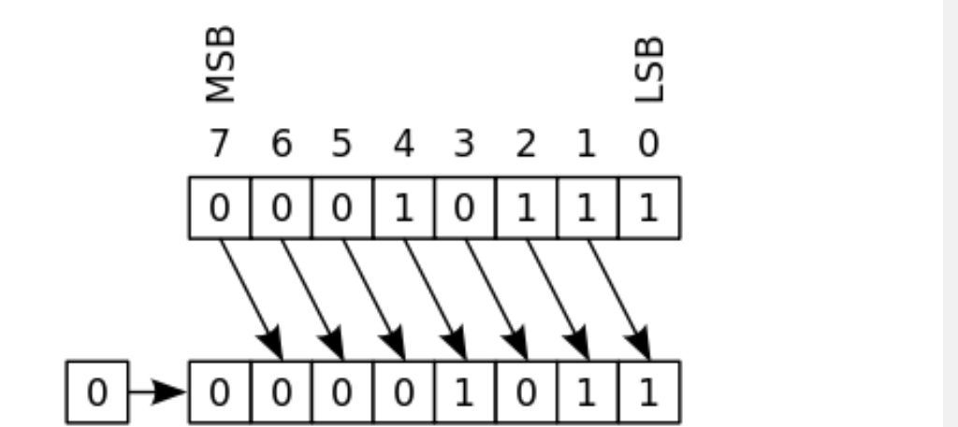
Right Shift>>
Here, we take 23 in int i.
and perform right shift operation i.e. i>>1;
Then print the value of I it will show 11.

Slide 141
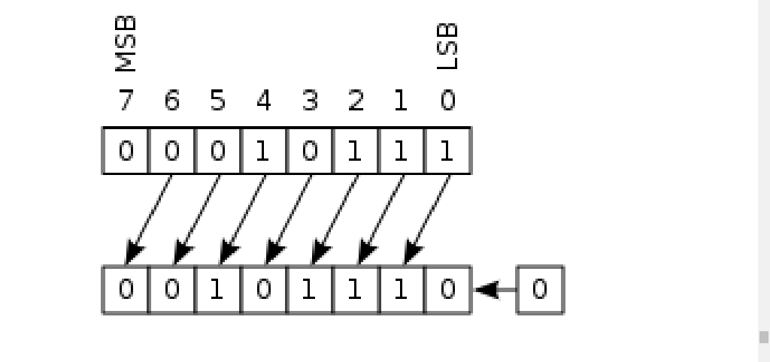
Left shift<<
Here, we take 23 in int i.
and perform left shift operation i.e. i<<1;
Then print the value of I it will show 46.

Slide 142
Miscellaneous Features
Enumeration (or enum)
Typedef
Typecasting
Unions
BitFields
Pointer to function
Function with variable number of arguments
Creating user library(static or dynamic).
Compilation an options
Build tool(make and makefile)

Slide 143
Enumeration (or enum)
Enumeration (or enum) is a user defined data type in C. It is mainly used to assign names to integral constants, the names make a program easy to read and maintain.
enum State {Working = 1, Failed = 0};
The keyword 'enum' is used to declare new enumeration types in C.
Variables of type enum can also be defined. They can be defined in two ways:
enum week{Mon, Tue, Wed};
enum week day; //
Or
enum week{Mon, Tue, Wed}day;
Two enum names can have same value. For example, in the following C program both ‘Failed’ and ‘Freezed’ have same value 0.
#include <stdio.h>
enum State {Working = 1, Failed = 0, Freezed = 0};
int main()
{
printf("%d, %d, %d", Working, Failed, Freezed);
return 0;
}

Slide 144
Enumeration (or enum)
If we do not explicitly assign values to enum names, the compiler by default assigns values starting from 0. For example, in the following C program, sunday gets value 0, monday gets 1, and so on.
#include <stdio.h>
enum day {sunday, monday, tuesday, wednesday, thursday, friday, saturday};
int main()
{ enum day d = thursday; printf("The day number stored in d is %d", d);
return 0; }
We can assign values to some name in any order. All unassigned names get value as value of previous name plus one.
#include <stdio.h>
enum day {sunday = 1, monday, tuesday = 5, wednesday, thursday = 10, friday, saturday};
int main()
{ printf("%d %d %d %d %d %d %d", sunday, monday, Tuesday, wednesday, thursday, friday, saturday);
return 0; }
The value assigned to enum names must be some integeral constant, i.e., the value must be in range from minimum possible integer value to maximum possible integer value.
All enum constants must be unique in their scope. For example, the following program fails in compilation.
enum state {working, failed};
enum result {failed, passed};
int main() { return 0; }

Slide 145
Typedef
which you can use to give a type a new name.
typedef unsigned char BYTE;
By convention, uppercase letters are used for these definitions to remind the user that the type name is really a symbolic abbreviation, but you can use lowercase, as follows −
typedef unsigned char byte;
You can use typedef to give a name to your user defined data types as well.
typedef vs #define
#define is a C-directive which is also used to define the aliases for various data types similar to typedef but with the following differences −
typedef is limited to giving symbolic names to types only where as #define can be used to define alias for values as well, q., you can define 1 as ONE etc.
typedef interpretation is performed by the compiler whereas #define statements are processed by the pre-processor.

Slide 146
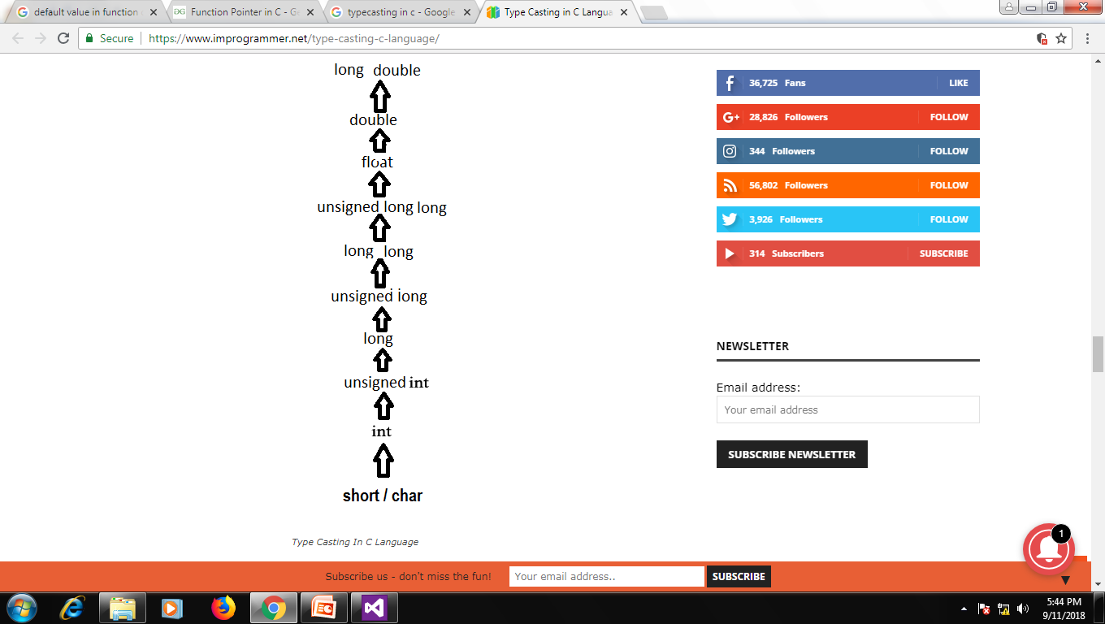
Typecasting
Type casting is a way to convert a variable from one data type to another data type.
You can convert values from one type to another explicitly using the cast operator.
There are two types of type casting in c language that are Implicit conversions and Explicit Conversions.
IMPLICIT CONVERSION
Implicit conversions do not require any operator for converted. They are automatically performed when a value is copied to a compatible type in the program.
EXPLICIT CONVERSION
In C language, Many conversions, especially those that imply a different interpretation of the value, require an explicit conversion.
i.e. float a=(float)5/2;
Usual Arithmetic Conversion
The usual arithmetic conversions are implicitly performed to cast their values in a common type, C uses the rule that in all expressions except assignments, any implicit type conversions made from a lower size type to a higher size type as shown below:

Slide 147
DIFFERENCE BETWEEN TYPE CASTING AND TYPE CONVERSION
BASIS FOR COMPARISON | TYPE CASTING | TYPE CONVERSION
Definition | When a user can convert the one data type into other then it is called as the type casting. | Type Conversion is that which automatically converts the one data type into another.
Implemented | Implemented on two ‘incompatible’ data types. | Implemented only when two data types are ‘compatible’.
Operator | For casting a data type to another, a casting operator ‘()’ is required. | No operator required.
Implemented | It is done during program designing. | It is done explicitly while compiling.
Conversion | Narrowing conversion. | Widening conversion.

Slide 148
Unions
Like Structures, union is a user defined data type. In union, all members share the same memory location.
union test
{
int x, char y;
};
Here at a time we used only one of the member of union. We can’t access the both x and y at same time like in structure
Size of a union is taken according the size of largest member in union.
Like structures, we can have pointers to unions and can access members using arrow operator (->).

Slide 149
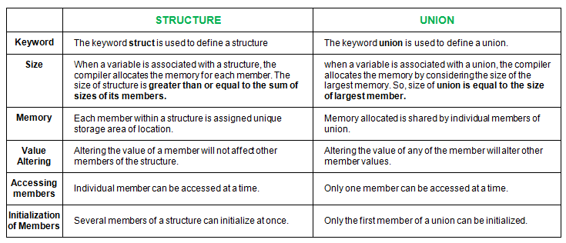
Unions VS Structure

Slide 150
Bit Fields
The idea is to use memory efficiently when we know that the value of a field or group of fields will never exceed a limit or is within a small range.
For example.
Structure Time
{
unsigned int hr;
unsigned int min;
unsigned int sec;
}vert;
Here vert required 12 bytes(12*8=96bits) of memory. And the values are sec= 1 to 59 OR min = 1 to 59 OR hr = 1 to 12 to store 59 we required 6 bits and for storing 12 we required 4 bits. Means 4 bits for hr, 6 bits for min and 6 bits for sec total 16bits are required. But we used 96 bits.
we can optimize the space using bit fields.
Structure Time
{
unsigned int hr:4;
unsigned int min:6;
unsigned int sec;:6
}vert;
Here only 4byte of memory allocate to vert and the reason is we used 32 bit system and in this one word is of 4 bytes(32 bits, one word is equal to size of processor register)
interesting facts about bit fields
A special unnamed bit field of size 0 is used to force alignment on next boundary.
We cannot have pointers to bit field members as they may not start at a byte boundary.
In C++, we can have static members in a structure/class, but bit fields cannot be static
Array of bit fields is not allowed.

Slide 151
Pointer to function
#include <stdio.h>
void add(int a, int b)
{ printf("Addition is %d\n", a+b); }
void subtract(int a, int b)
{ printf("Subtraction is %d\n", a-b); }
void multiply(int a, int b)
{ printf("Multiplication is %d\n", a*b); }
int main()
{
void (*fun_ptr_arr[])(int, int) = {add, subtract, multiply};
unsigned int ch, a = 15, b = 10;
printf("Enter Choice:\n0 for add, \n1 for subtract and \n2 for multiply\n");
scanf("%d", &ch);
if (ch > 2) return 0;
(*fun_ptr_arr[ch])(a, b);
return 0;
}
#include <stdio.h>
void fun(int a)
{ printf("Value of a is %d\n", a); }
int main()
{
void (*fun_ptr)(int) = &fun;
(*fun_ptr)(10);
return 0;
}
If we remove bracket, then the expression “void (*fun_ptr)(int)” becomes “void *fun_ptr(int)” which is declaration of a function that returns void pointer.
Unlike normal pointers, a function pointer points to code, not data. Typically a function pointer stores the start of executable code.
Unlike normal pointers, we do not allocate de-allocate memory using function pointers.
A function’s name can also be used to get functions’ address.
void (*fun_ptr)(int) = fun;
fun_ptr(10);
Like normal pointers, we can have an array of function pointers.
Function pointer can be used in place of switch case.

Slide 152
Function with variable number of arguments
Some times we required variable number of arguments, the C programming language provides a solution for this situation you can write that kind of function.
But for this you have to use stdarg.h header file
Define a function with its last parameter as ellipses and the one just before the ellipses is always an int which will represent the number of arguments.
Create a va_list type variable in the function definition. This type is defined in stdarg.h header file.
Use int parameter and va_start macro to initialize the va_list variable to an argument list. The macro va_start is defined in stdarg.h header file.
Use va_arg macro and va_list variable to access each item in argument list.
Use a macro va_end to clean up the memory assigned to va_list variable.

Slide 153
Function with variable number of arguments
#include <stdio.h>
#include <stdarg.h>
int main() {
printf("sum of 2, 3, 4, 5 = %d\n", Sum(4, 2,3,4,5));
printf("sum of 5, 10, 15 = %d\n", Sum(3, 5,10,15));
}
int Sum(int num,...)
{
va_list valist;
int sum = 0;
int i;
va_start(valist, num);
for (i = 0; i < num; i++)
sum += va_arg(valist, int);
va_end(valist);
return sum;
}

Slide 154
User created Library
What is library?
Many times we start writing our code by main and our program execution also start from main. And that program is written typically to solve any problem.
To solve that problem we divide it in sub problem means we create functions.
And we fill that some functions are very useful or the same functions we required in many project(application).
In a such situation I need something that will hold my binary file, these file contain machine code of all commonly required functions or micro variables.
Very important this does not have main function.
This library are divided in two category
Static library
Dynamic library
File name must be start with lib

Slide 155
Static library
gcc -c {filename}.c
to create object file use –c option
ar -rcs libmy_math.a file1.o file2.o file3.o
ar command for create archives.
options r for replace, c for create, s for index.
Then filename always start with lib{anyName}.a end with .a(extension)
How tell linker to look in our library:
gcc mainProgram.c -L. –lmy_math
-L says “look in directory for library files”0
. (the dot after ‘L’) represents the current working directory
-l says “link with this library file”
my_math is the name of our library. Note that we omitted the “lib” prefix and “.a” extension.
Static libraries, also called “archives”, are just collections of object files that contain functions.
Static libraries are joined(attached) to the main module of a program during the linking stage of compilation before creating the executable file.
After a successful link of a static library to the main module of a program, the executable file will contain both the main program and the library.
Note in Linux environment file extension is .a file but in Windows it is .lib file.
How to create static library?
To create library we need one or more object files(.o file) zips them up, and generates an archive file (ends in .a or .lib)

Slide 156
Dynamic library
gcc -fPIC -c {filename}.c
to create object file use –c option
This flag stands for Position Independent Code, a characteristic required by shared libraries.
gcc –shared -o libmy_math.so *.o
-shared key tells the compiler to produce a shared object which can then be linked with other objects to form an executable.
-o to give file name.
*.o take all files with extension o
How tell linker to look in our library:
gcc mainProgram.c -L. –lmy_math
-L says “look in directory for library files”0
. (the dot after ‘L’) represents the current working directory
-l says “link with this library file”
my_math is the name of our library. Note that we omitted the “lib” prefix and “.a” extension.
The concept of a library is powerful because it allows an end user to link functions via their object file’s during either run-time or compile time — this differs depending on the type of library you create.
Static library is a collection of object files.
while dynamic or shared library is a collection of functions compiled and stored in an executable with purpose of being linked by other programs at run-time.
Note in Linux environment file extension is .so file but in Windows it is .dll file.
How to create static library?
To create library we need one or more Position Independent object files(.o file) club them together, for generate Shared Library(ends in .so or .dll)

Slide 157
Compilation an options revision
To Produce all the intermediate files
g++ -save-temps main.cpp
File Compilation g++ main.cpp
To Specify the Output Executable Name
g++ -o main main.cpp
To provide standard of cpp
g++ -std=c++11 main.cpp
To Enable all warnings
g++ -Wall main.cpp
To compile multiple cpp file
g++ -o main main.cpp algo1.cpp algo2.cpp
To Produce only the preprocessor output
g++ -E main.cpp > main.i
To link multiple object file
g++ -o main main.o algo1.o algo2.o
To Produce only the assembly code
g++ -S main.cpp
To Produce only the compiled code
g++ -c main.cpp

Slide 158
Build Tool
Makefille
#here all is first target
#and main is dependency
all: main
#here main is a target
#main.o algo1.o algo2.o are the dependency
#new line gcc command is given
main: main.o algo.o algo2.o
gcc main.o algo.1o algo2.o –o main
main.o: main.c
gcc -c main.c
algo1.o: algo1.c
gcc -c algo1.c
algo2.o: algo.c
gcc -c algo2.c
clean:
del /f *.o or rm –f *.o
Makefille
#here all is first target
all:
gcc main.c algo.1c algo2.c –o main
clean:

Slide 159
Build Tool
$@ is a macro that refers to the target
$< is a macro that refers to the first dependency
$^ is a macro that refers to all dependencies
% is a macro to make a pattern that we want to watch in both the target and the dependency
Makefille
#declare the variables
CC=gcc
CFLAGS=-c –Wall
all: main
main: main.o algo.o algo2.o
$(CC) main.o algo.1o algo2.o –o main
main.o: main.c
$(CC) $(CFLAGS) main.c
algo1.o: algo1.c
$(CC) $(CFLAGS) algo1.c
algo2.o: algo.c
$(CC) $(CFLAGS) algo2.c
clean:
del /f *.o or rm –f *.o
Makefille
CC = gcc
CFLAGS = -c -Wall
all: main.exe
%.o: %.c
$(CC) $(CFLAGS) $^
main.exe: main.o algo1.o algo2.o
$(CC) -o $@ $^
clean:
del /f *.o *exe

